Slide 1
Colonic J‑pouch versus side‑to‑end anastomosis for rectal cancer: a systematic review and meta‑analysis of randomized controlled trials
Journal club presentation
Department of general surgery
Kanyakumari government medical college
Dr Jonathan abish david
2nd yr gen surg post graduate

Slide 2
Zheng Wang
Department of Science and Technology, West China Hospital, Sichuan
University, Chengdu, China
Published in august 2021

Slide 3
Introduction
Total mesorectal excision (TME) is the best available treatment for rectal cancer for the majority of patients with mid and upper rectal cancer
After TME, the most widely used reconstructive technique is straight coloanal anastomosis.
However, because the sigmoid colon is usually excised during surgery which decreases the storage volume of stool, there is a common problem seriously influencing the life quality of patients, including increased tool frequency, urgency and incontinence, which is termed as “anterior resection syndrome (ARS)”

Slide 4
about 19–56% of patients would suffer from ARS
Thus, modifications were made in the straight anastomotic technique for better functional outcomes
Colonic J-pouch anastomosis was introduced in 1986. A 5–8 cmlong colonic segment was considered as the optimum size of the J-pouch
In some patients with the narrow pelvis or bulky mesentery, we are unable to perform colonic J-pouch
Thus another modified anastomotic technique, side-to-end anastomosis, which has been used since 1966, has gained attention

Slide 5
Side-to-end anastomosis usually needs a 3–5 cm-long colonic segment
Multiple studies on the literature have shown that compared with straight anastomosis, side-to-end anastomosis and colonic j pouch has advantages in bowel functional and operative outcomes
Up to now, there is no clear evidence on which one of the two anastomotic techniques is better.
Therefore, this meta-analysis was conducted to compare surgical and bowel functional outcomes and QoL in patients undergoing resection of a mid to upper rectal cancer with reconstruction using either a colonic J-pouch or a side-to-end pouch

Slide 7
METHODS
This study was performed according to the recommendations of the preferred reporting items for systematic reviews and meta-analyses statement (PRISMA)
In this study, colonic J-pouch was performed with 4–8 cm long colonic segment, while side-to-end anastomosis was performed with 3–6 cm-long colonic segment

Slide 8
Study selection
Systematic literature search was performed in PubMed, Embase and Cochrane
All randomized controlled trials (RCTs) comparing colonic J-pouch with side-to-end anastomosis for rectal cancer were enrolled
Non-randomized trials, such as retrospective studies, reviews, meta-analyses, and comments, were excluded

Slide 10
Outcomes of interest
Main outcomes were bowel functional outcomes and QoL.
Bowel functional outcomes mainly included three indexes: stool frequency, urgency, incomplete defecation and incontinence
bowel functional outcomes and QoL were recorded at three time periods:
short term (< 8 months),
medium term (8–18 months), and
long term (> 18 months)

Slide 11
The secondary outcomes were surgical outcomes including
Operative time,
Postoperative hospital stay,
postoperative complications,
reoperation,
mortality.

Slide 12
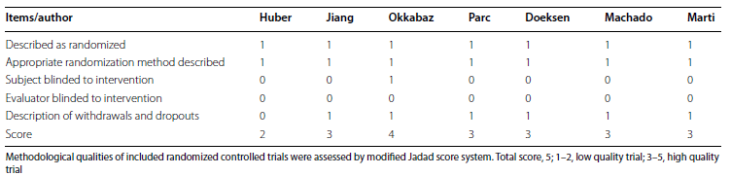
Quality assessment
modified Jadad score system to assess the methodological quality of the randomized controlled trials
total score, 5; 1–2, low quality; 3–5, high quality

Slide 13
Statistical analysis
Review Manager version 5.3 (The Cochrane Collaboration, Software Update, Oxford) used for data analyses
Pvalue < 0.05 was considered statistically significant

Slide 14
Nine articles incorporating 7 trials were enrolled in this meta-analysis
A total of 696 patients (330 by colonic J-pouch and 366 by side-to-end) were included.

Slide 15
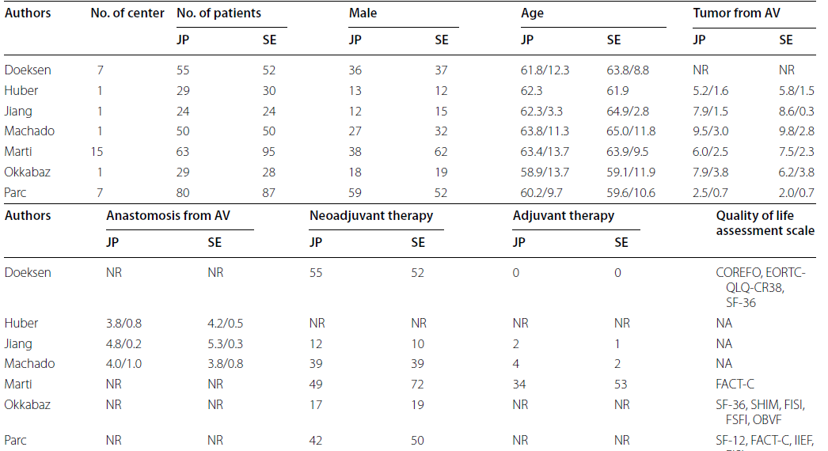
Study characteristics

Slide 16
Results
Patient demographics
No significant differences were found between colonic J-pouch and side-to-end groups in terms of the male sex, the distance of the distal edge of the tumor from the anal verge, the distance of the anastomosis from the anal verge, or neoadjuvant/adjuvant therapy

Slide 17
Bowel function outcomes
Baseline:
stool frequency – comparable (3 trials)
urgency - comparable between 2 groups (3 trials) J-pouch 11%, side-to-end 8%
Incomplete defecation comparable between 2 groups (2 trials)
J-pouch 4%, side-to-end 1%
Short term:
Stool frequency – comparable ( 5 trials)
Urgency – comparable ( 4 trials) J-pouch 30%, side-to-end 41%,
Incomplete defecation – comparable (3 trials) J-pouch 35%, side-to-end 27%

Slide 18
Medium term:
Stool frequency – comparable (4 trials)
Urgency – comparable (3 trials) J-pouch 37%, side-to-end 48%
Incomplete defecation – comparable (2 trials)
J-pouch 36%, side-to-end 51%
Long term:
Stool frequency – comparable (3 trials)
Urgency – comparable (2 trials), J-pouch 22%, side-to-end 39%
Incomplete defecation – comparable (2 trials)
J-pouch 33%,side-to-end 39%

Slide 19
Quality of life
Different trials used different questionnaires to assess QoL
Only two trials which both used SF-36 questionnaire could be pooled together and these two trials involving 164 patients (84 by colonic J-pouch and 80 by side-to-end) in total served for evaluation of QoL in this study

Slide 20


Slide 21


Slide 22
At the baseline, the physical function and social function were comparable between J-pouch and side-to-end groups; however, the general health perception was slightly better in J-pouch
At short term and medium term, the physical function, social function and general health perception were all similar in two groups
Other QOL questionnaires are COloREctal Functional Outcome(COREFO) , EORTC-QLQ-CR38 , SF-36, Functional Assessment of Cancer Therapy-Colorectal (FACT-C) , Sexual Health Inventory for Men(SHIM), Fecal Incontinence Severity Index (FISI)

Slide 23
Surgical outcomes
The pooled mean operative time was 216 min in J-pouch group and
209 min in side-to-end group
The pooled mean postoperative hospital stay was 20.9 days in J-pouch group and 27.8 days in side-to-end group
There was no statistically significance between the two groups in terms of operative time and postoperative hospital stay

Slide 24
The pooled postoperative complication rate, reoperation rate, and mortality rate were 29.9%, 18.7%, and 1.7% in J-pouch group and 26.7%, 13.1%, and 0.4% in side to- end group, respectively.
The postoperative complications, reoperation and mortality were all comparable between two groups
The post operative complications studied were wound infection, bowel obstruction, anastomotic leakage, anastomotic stricture, rectovaginal fistula

Slide 27
Limitations
High heterogenesity in some analyses whichmay be influenced by factors such as patients’s sex, surgeon’s experience, the surgical technique and (neo)adjuvant therapy
Different trials used different QoL questionnaires
None of these nine studies reported the outcomes separately for men and women
Nighttime incontinence was not analysed because no studies reported this outcome

Slide 28
Conclusions
The currently limited evidence suggests that colonic J-pouch and side-to-end anastomosis are comparable in terms of bowel functional outcomes, QoL, and perioperative outcomes
A large sample randomized controlled study comparing colonic J-pouch and side-to-end anastomosis for rectal cancer is warranted

Slide 29
References
1. Ortiz H, Armendariz P. Anterior resection: do the patients perceive any clinical benefit? Int J Colorectal Dis. 1996;11(4):191–5.
2. Bregendahl S, Emmertsen KJ, Lous J, Laurberg S. Bowel dysfunction after low anterior resection with and without neoadjuvant therapy for rectal cancer: a population-based cross-sectional study. Colorectal Dis. 2013;15(9):1130–9.
3. Juul T, Ahlberg M, Biondo S, et al. Low anterior resection syndrome an quality of life: an international multicenter study. Dis Colon Rectum. 2014;57(5):585–91.
4. Juul T, Battersby NJ, Christensen P, et al. Validation of the English translation of the low anterior resection syndrome score. Colorectal Dis. 2015;17(10):908–16.
5. Ekkarat P, Boonpipattanapong T, Tantiphlachiva K, Sangkhathat S. Factors determining low anterior resection syndrome after rectal cancer resection: a study in Thai patients. Asian J Surg. 2016;39(4):225–31.
6. Hughes DL, Cornish J, Morris C. Functional outcome following rectal surgery-predisposing factors for low anterior resection syndrome. Int J Colorectal Dis. 2017;32(5):691–7.

Slide 30
7. Lazorthes F, Fages P, Chiotasso P, Lemozy J, Bloom E. Resection of the rectum with construction of a colonic reservoir and colo-anal anastomosisfor carcinoma of the rectum. Br J Surg. 1986;73(2):136–8.
8. Parc R, Tiret E, Frileux P, Moszkowski E, Loygue J. Resection and coloanalanastomosis with colonic reservoir for rectal carcinoma. Br J Surg.1986;73(2):139–41.
9. Hida J, Yasutomi M, Fujimoto K, et al. Functional outcome after low anteriorresection with low anastomosis for rectal cancer using the colonicJ-pouch. Prospective randomized study for determination of optimumpouch size. Dis Colon Rectum. 1996;39(9):986–91.
10. Otto S, Kroesen AJ, Hotz HG, Buhr HJ, Kruschewski M. Effect of anastomosislevel on continence performance and quality of life after colonic J-pouch reconstruction. Dig Dis Sci. 2008;53(1):14–20.
11. Brown CJ, Fenech DS, McLeod RS. Reconstructive techniques afterrectal resection for rectal cancer. Cochrane Database Syst Rev.2008;2:CD006040.
12. Harris GJ, Lavery IJ, Fazio VW. Reasons for failure to construct the colonicJ-pouch. What can be done to improve the size of the neorectal reservoir should it occur? Dis Colon Rectum. 2002;45(10):1304–8.
13. Zehnder MA. 2 variations of the sigmoid-rectum resection suture. I. Sideto- end anastomosis of the sigmoid-rectum. II. Extraperitoneal transpositionf the colonic resection suture. Helv Chir Acta. 1968;35(5):52634.
14. Zhang YC, Jin XD, Zhang YT, Wang ZQ. Better functional outcome provided by short-armed sigmoid colon-rectal side-to-end anastomosis after laparoscopic low anterior resection: a match-paired retrospective studyfrom China. Int J Colorectal Dis. 2012;27(4):535–41.
15. Doeksen A, Bakx R, Vincent A, et al. J-pouch vs side-to-end coloanal anastomosis after preoperative radiotherapy and total mesorectal excision for rectal cancer: a multicentre randomized trial. Colorectal Dis.
2012;14(6):705–13

Slide 31
Thank you

