Slide 1
Comparative study between laparoscopic CBD exploration and ERCP plus Lap.cholecystectomy for choledocholithiasis
Journal club presentation
- Dr.Malathi.S.A.

Slide 2
Prospective randomised study
Published on 1 June 2019 in International surgery journal
Study conducted at
    General surgery department, Al-Azar University , Cairo, Egypt
    General surgery department , Theodor Bilhariz Research insititute, Giza, Egypt
    From March 2017 to September 2018

Slide 3
Aim & Objective
To compare the efficacy , safety & surgical outcomes of the LCBDE With ERCP followed by LC .
To determine the most appropriate approach for patients with choledocholithiasis

Slide 4
Methods
Prospective randomised study
Included 50 patients with cholecysto- choledocholithiasis
Divided into
  Group A – 25 patients – transcystic LCBDE & Stone extraction with LC in one stage
  Group B – 25 patients – ERCP followed by LC in 2 stages

Slide 5
Inclusion criteria
Classic biliary pain
Ultrasonographic demonstration of cholecystolithiasis
CBD diameter > 6mm ( 5 mm upto 50 yrs , then 5 + 1mm per decade )
Demonstration of CBD stones by USG or MRCP or EUS
Intrahepatic duct dilatation in usg or CT
Platelet count more than 1 lakh
Prothrombin time >3 sec

Slide 6
Exclusion Criteria
Evidence of :
cholangitis & pancreatitis
Cirrhosis
Liver mass /abscess
Neoplasm
Suppurative or necrotizing cholecystitis
Gallbladder empyema or perforation

Slide 7
Laboratory Investigations done
CBC
Prothrombin time
Partial thromboplastin time
INR
LFT
Serum Amylase , lipase

Slide 8
Radiological study
Abdominal USG
MRCP
EUS
In patients with suspected CBD stones ( elevated bilirubin , liver enzymes or ultrasound suspicion of CBD stones )

Slide 9
Operative technique in Group A
Broad spectrum 3rd generation cephalosporin given at time of induction
Routine 4 port Reddick laparoscopic cholecystectomy performed using open method for pneumo-peritoneum
Umbilical port – infraumbilical – 10mm – using hasson technique
Pressure – 12- 15 mmHg
10 mm epigastric port
Two 5mm ports – 1 just lateral to rectus at right midclavicular line – opp. To fundus . & other at right anterior axillary line at level of umbilicus

Slide 10
Cystic duct & artery identified
Intraop usg done – integrity of CBD checked
Distal clip applied to duct near GB
Small incision in cystic duct performed near to clip using lap.micro scissors
Duct milked using Maryland forceps for clearence of cystic duct from stones
Cystic duct dilated & cannulated by size 5 ureteric catheter – screened with c arm

Slide 11
Indications of various approaches of LCBDE
TRANSCYSTIC APPROACH | CHOLEDOCHOTOMY APPROACH
A Patent cystic duct | Dilated CBD more than 7 -8 mm
A limited number of stones | Accessible porta hepatis
Small stone size ( less than cystic duct size )
Stones located below CD – CBD junction
Adequate biliary anatomy of the CD-CBD junction

Slide 12
Transcystic approach
Dilatation of cystic duct done
Instrumental stone extraction performed using a three-wire soft dormia basket under fluoroscopic guidance or under direct visual cholangioscopic guidance

Slide 13
Choledochotomy approach
Anterior wall of CBD dissected
Longitudinal incision made into CBD
Instrumental stone extraction done
Primary CBD closure was done using PDS 4-0 - if complete CBD vacuity obtained
Or
External biliary drainage was done using T-tube exteriorized the site of most lateral trocar
Control cholangiography done at postop day 10 to exclude residual CBD stones / biliary leak

Slide 14
Endoscopic stone extraction - Group B
ERCP performed with side viewing duodenoscope
Bile duct cannulated with wire-guided sphicterotome & hydrophilic guide wire
Biliary sphncterotomy was done using cutting & coagulation
Stones extracted using Dormia basket or extraction balloon
Pts kept under observation for 6 – 8 hrs
Pts underwent LC in another session

Slide 15
Follow up
Postop followup done at
1 week
1 , 6 months
At any time if symptoms developed

Slide 16
Pain severity
Condition of wound
History of jaundice
LFT & abdominal usg done at 1 moth followup to assess the status of CBD

Slide 17
Statistical analysis
Quantitative data – mean + standard deviation
Qualitative data – number & percentage
T-Student test – for numerical data
Chi-square test – for qualitative data
P value of < 0.05 –considered significant

Slide 18
Results :
age : between 21 to 70 yrs
Mean age in grp A – 47.24
Mean age in grp B – 44.76
SEX –
Male – 9 ( 30%)
Female – 41(70 %)

Slide 19
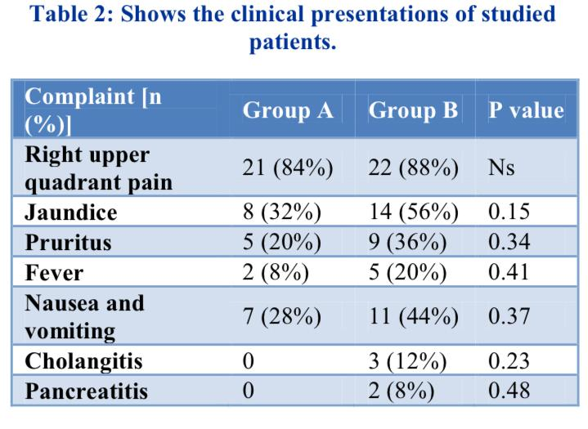

Slide 20
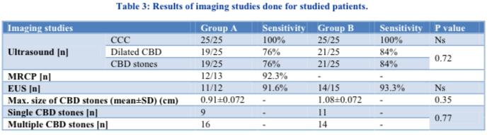

Slide 21
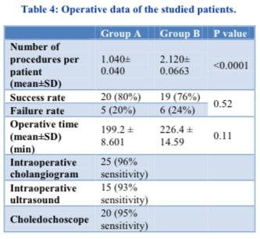

Slide 22
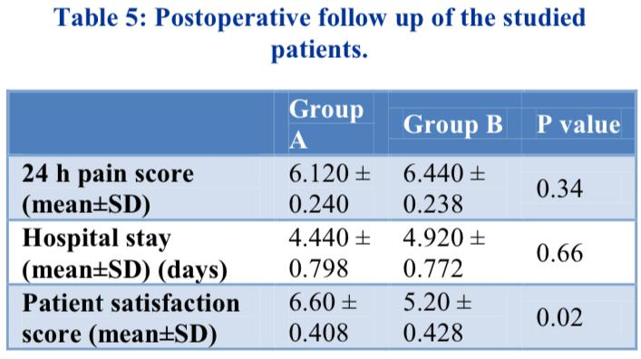

Slide 23
Both were similar in terms of clearance rate , operative time, postoperative complications, retained stones & postoperative length of stay
But there was a significant difference in number of procedures & patient satisfaction

Slide 24
Conclusion
LCBDE is better in terms of fewer procedure & better satisfaction compared with ERCP + LC
Hence , this study suggests that one – stage management is the treatment of choice for patients with choldecysto-choledocholithiasis

Slide 25
Merits of the study
LCBDE help avoid dicision of choledochal sphincter in young adults , there by avoiding :
Loss of normal physiological barrier, long term complications such as ampullary stenosis , duodenobiliary reflux, recurrent stone formation
Morbidity is 2 times lower in LCBDE
Postponing LCBDE makes it difficult due to adhesions at the area of callots triangle

Slide 26
Demerits of the study
Small size of the cohort
Need for advanced instruments & imaging modalities
Learning curve is more

Slide 27
Thank you

