Slide 1
INTRACORPEAL REINFORCEMENT WITH BARBED SUTURES IS ASSOCIATED WITH LOW ANASTAMOTIC LEAKAGE RATES IN LAPAROSCOPIC LOW ANTERIOR RESECTION FOR RECTAL CANCER
HOD – Prof Dr. J.A. Jayalal M S.,FRCS.,Phd
Chief – Dr. K. Rajkumar M.S.,
Assistants proffessors
Dr. Ajin Manovah M.S
Dr. Ajin Daniel M.S
Review by DR.M.NARESH
First year postgraduate
Department of general surgery

Slide 2
Background
Though laparoscopic surgery are superior to open surgeries in case of rectal cancers it is helpless in the area of prevention of anastamotic leaks which is one of the most severe post operative complications of rectal surgery
It also increase postoperative stay and mainly postpone the postoperative chemoradiotheraphy
It is mainly associated with anastamotic level,blood supply,techniques,enteric pressure etc ,
Previous studies have shown that dog ears a spot formed on bilateral intersecting margins on distal rectal stump which is a weak anastamotic site and lack blood supply and the potent area for leak
In addition studies of reinforcement materials especially barbed sutures have found its ways of advantage in various modalities of surgeries

Slide 3
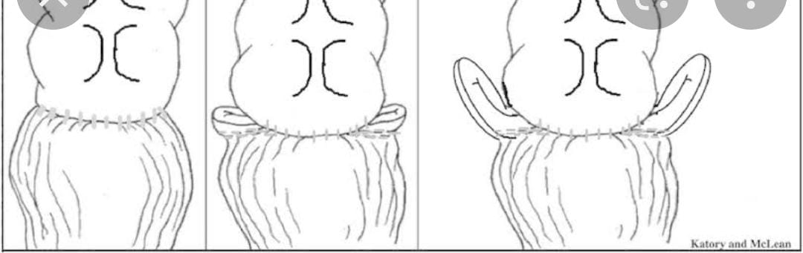

Slide 4
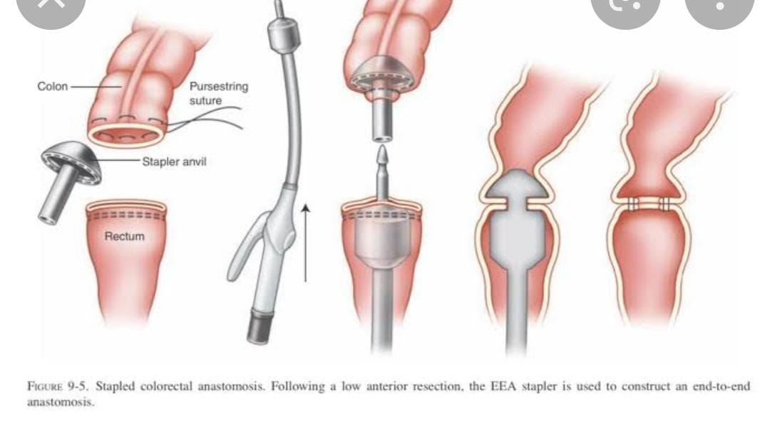

Slide 5
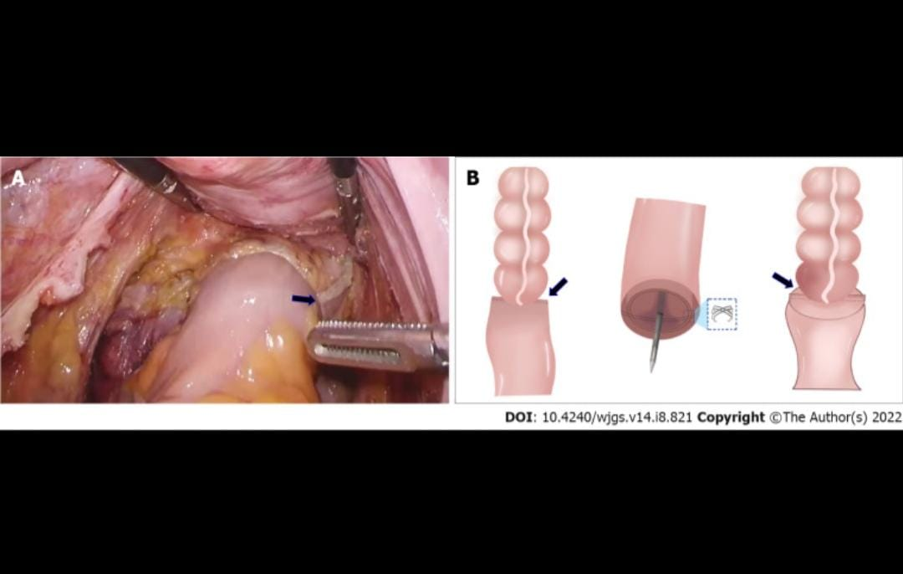

Slide 6
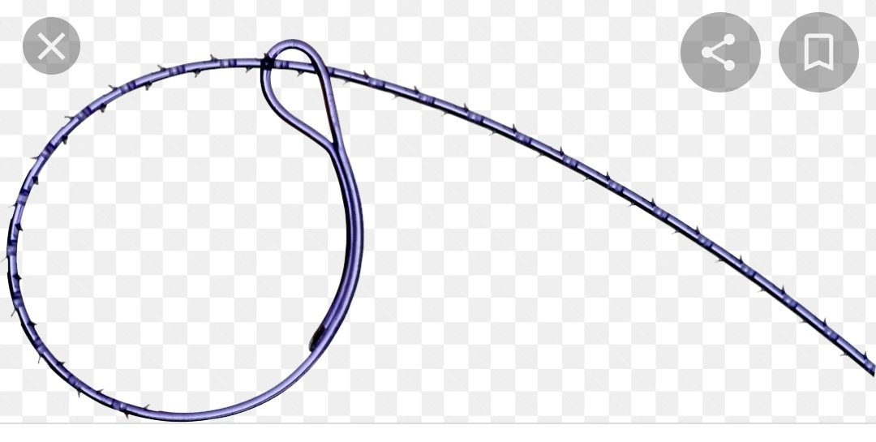

Slide 7
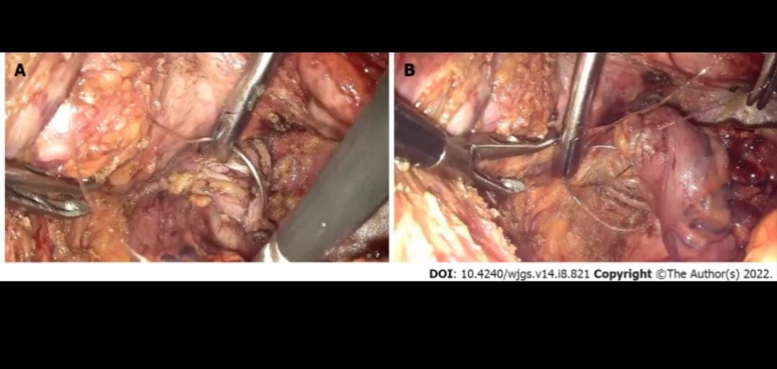

Slide 8
No studies have conducted to find out the efficacy of barbed suture in laparoscopic rectal surgeries hence taking this into consideration retrospective study is been conducted and compared the incidence of anastamotic leak in LAR wher they are subjected to reinforcement with barbed suture and those not

Slide 9
Cases taken:Consecutive cases underwent laproscopic LAR FROM MARCH 2018 TO FEB 2021
Center:Department of gastrointestinal surgery,renji hospital ,school of medicine,shangaijio tung university,shangai,china
Type of data collection:retrospective
Method used:propensity score matching to reduce biases and anastamotic leak incidence in the matched cohort were compared
Ethical committee:Approved
Received:9 may 2022
Accepted :23 august 2022
Published online:9 September 2022
Level of evidence:Level 2

Slide 10
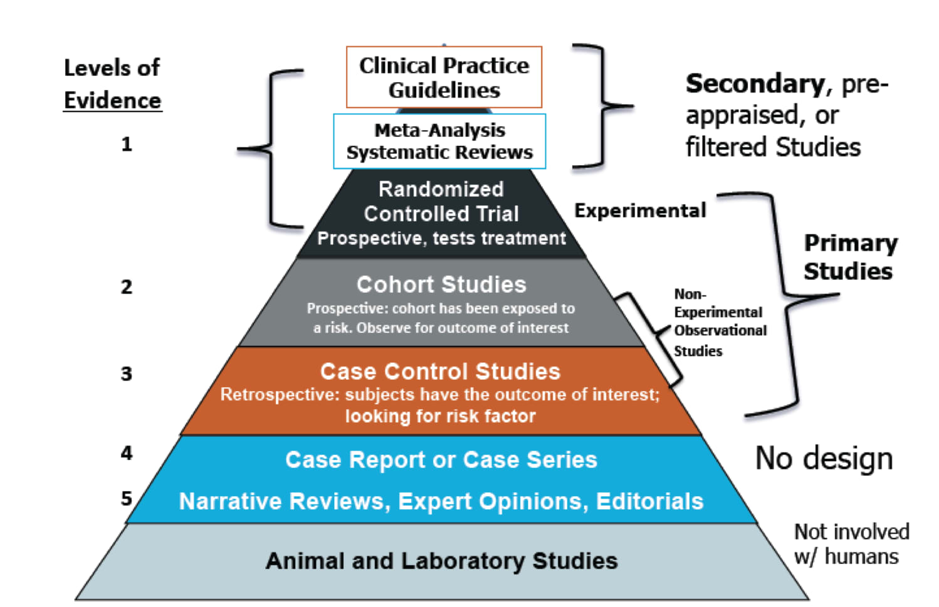

Slide 11
Inclusion criteria :
1) cases diagnosed as rectal cancer according to preoperative endoscopy and postoperative pathological reports;
2) cases underwent laparoscopic LAR for rectal cancer for the frst time;
3) cases underwent sigmoid-rectal end-to-end anastomosis and distance of colorectal anastomosis from the anal verge ranged from 1.0 to 5.0 cm;
(4) cases with age of 18–75 years

Slide 12
Exclusion criteria
1)distant metastasis or combined with other malignant tumors according to preoperative examinations, such as computed tomography (CT) and magnetic Resonance imaging
2) cases underwent laparoscopic Hartmann’s procedure and abdominoperineal resection;
3) cases sufered a conversion to laparotomy;
4) cases underwent protective stomas when there was positive leak test, obvious anastomotic tension or no enough
anastomotic blood supply (juded by indocyanine green (ICG) fuorescence imaging analyses);
(5) cases without intact medical records.

Slide 13
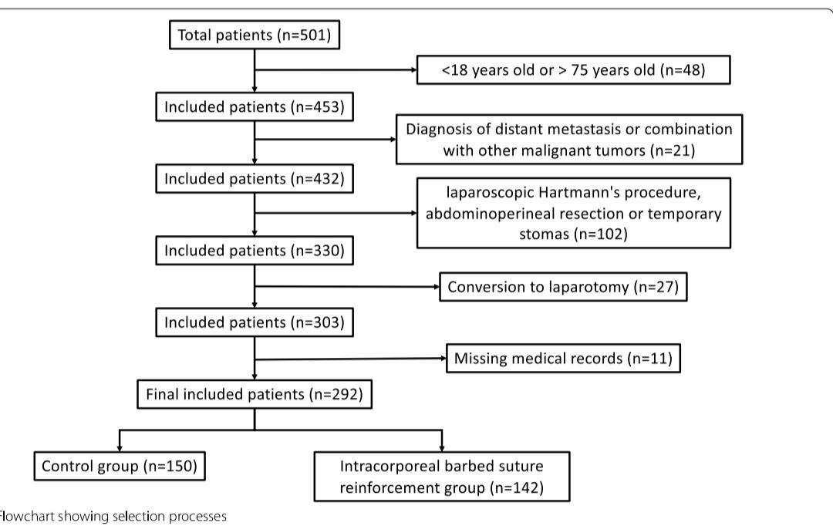

Slide 14
SURGICAL AND FOLLOW UP PROCEDURES
Preopeorative preperations and surgical procedures are done by the same surgical team
Five ports were used surgical procedures are done based on the radical surgery principle
The rectum association and lymphnodes dissection were conducted laparascopically and circular stapler used for sigmoid rectal end to end anastomosis
Anastamotic leak test were conducted using ICG and positive leak test resulting patients are provided with protective stoma and were excluded

Slide 15
The learning curve is accompalished by the expertise surgeons and time bias is minimal in this study
V-LOC barbed suture was used to close the gap between mesocolon and mesorectum and strengthen the dog ear areas which is the intersecting areas between linear cutting lines for transecting rectum and circular cutting lines for sigmoid rectal end to end anastomosis
In the control group no reinforcement was not done and negative suction abdominal drains were placed for all the patients
The follow up procedure were mainly based on NCCN GUIDELINES including medical history,physical examination,cancer biomarkers,chest and abdominalpelvis CT/MRI

Slide 16
DATA COLLECTION:
The collected data included basline charactristics (age,sex,body mass index,ASA status),operative recording (surgical timing,estimated blood loss,anastamotic level)and postoperative data(AL incidence rate,ventilation time)
The definition of AL was referred to proposal of ISREC which is clinical symptoms of leakage (fever ,abdominal pain),pelvic abcess confirmed by CT,water soluble contrast enema or endoscope or fecal discharge
Since subclincal leaks are hard to detect this study focussed on grade B/C LEAKS andthere may be incidence of delayed leaks so they have decided to select patients with no AL as patients with diverting stoma and with both absent clinical findings and imaging modalities and taking semifluid without leaks for 3 days before hospital discharge
Anemia levels albumin status levels and anastamotic levels which is defined as the distance between the anastamotic site from anal verge are taken

Slide 17
GRADING OF ANASTAMOTIC LEAKS
GRADE A:
Anastamotic leakge requiring no active intervention
GRADE B:
Leakage requiring therapeutic intervention but not relaparotomy
GRADE C:
Leakage requiring relaparotomy

Slide 18
STATISTICAL ANALYSIS
To reduce bias from covariates and achieve balance between the groups propensity score matching was conducted
Four variables including sex,BMI,adjuvant chemoradiotheraphy,and anastamotic level was selected and were matched with ratio 1:1 using the nearest neighbur method
Continuous variables depending on were normally distributed or not students t test or wilcoxan rank sum test was used for comparison between two groups
ANOVA test was used for intercomparison between multiple groups
For categorical variables chi square test or fisher extract test was used
All statistical analysis were conducted using the R SOFTWARE VERSION 4.03 and p<0.05 was considered statistically significant

Slide 19
INTROPERATIVE AND POSTOPERATIVE OUTCOMES
No difference in both hospital stay and post ventilation time in both the groups
and no conversion to laparotomy performed in both the groups
FEAUTURES | WITH BARBED SUTURES | CONTROL GROUPS
SURGICAL TIME | LONGER(P<0.001) | SHORTER
NUMBER OF RETRIVED LYMPH NODES | NO DIFFERENCE | NO DIFFERENCE
ESTIMATED BLOOD LOSS | NO DIFFERENCE | NO DIFFERENCE

Slide 20
ANASTAMOTIC LEAK INCIDENCE
As far as AL incidence the rate of leak is significantly lower in the case of reinforcement with barbed suture
Most anastamotic leak were grade b and only 4 of 19 was found to be grade c
no anastamotic stricture were found in both the groups as they are examined by colonoscopy six months after surgery

Slide 22
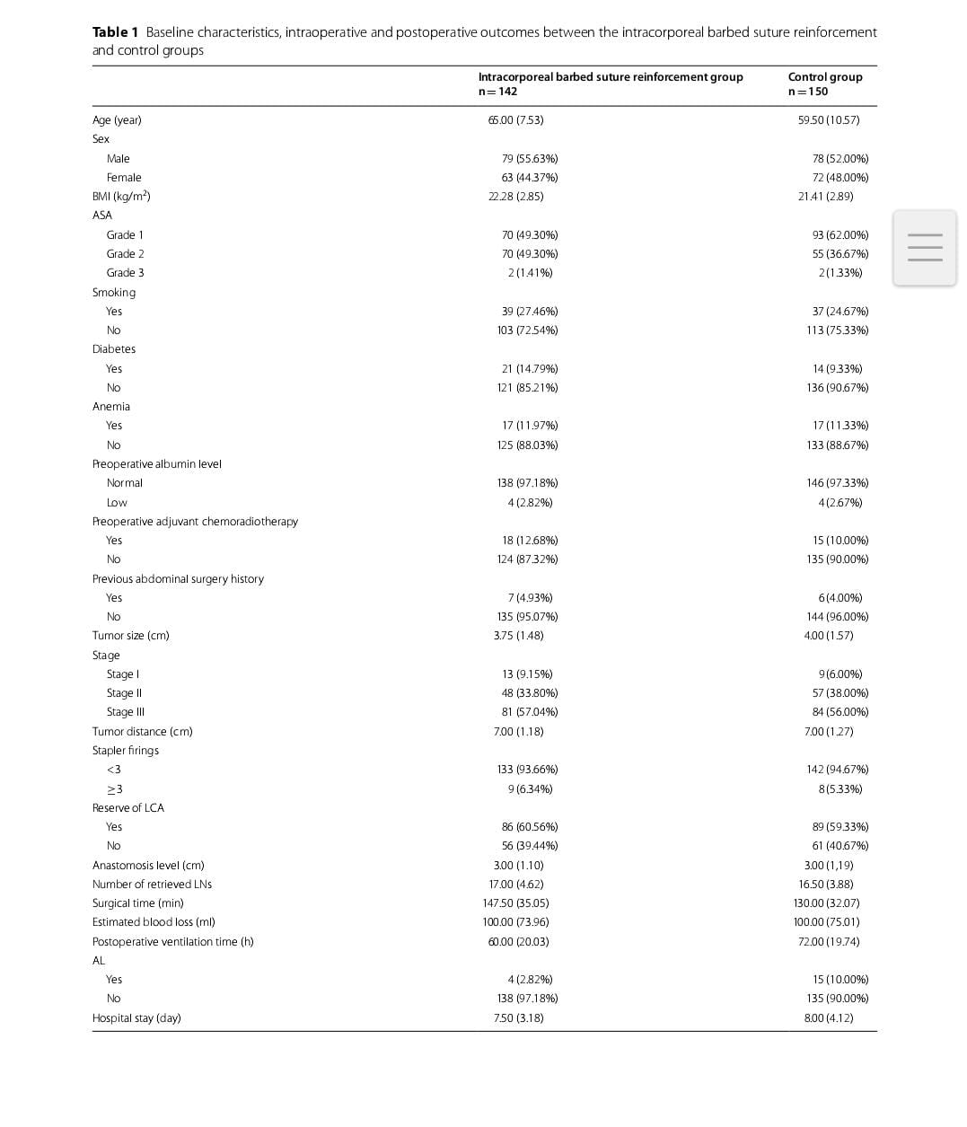

Slide 23
COMPARISONS IN MATCHED COHORT
4 COVARIATES were choosen for PSM analyses according to rule of thumb for PSM they are
Sex,pre op adjuvant chemoradiotheraphy,anastamotic level and surgical time
There was 123 barbed reinforcement cases and 123 control in matched cohort

Slide 24
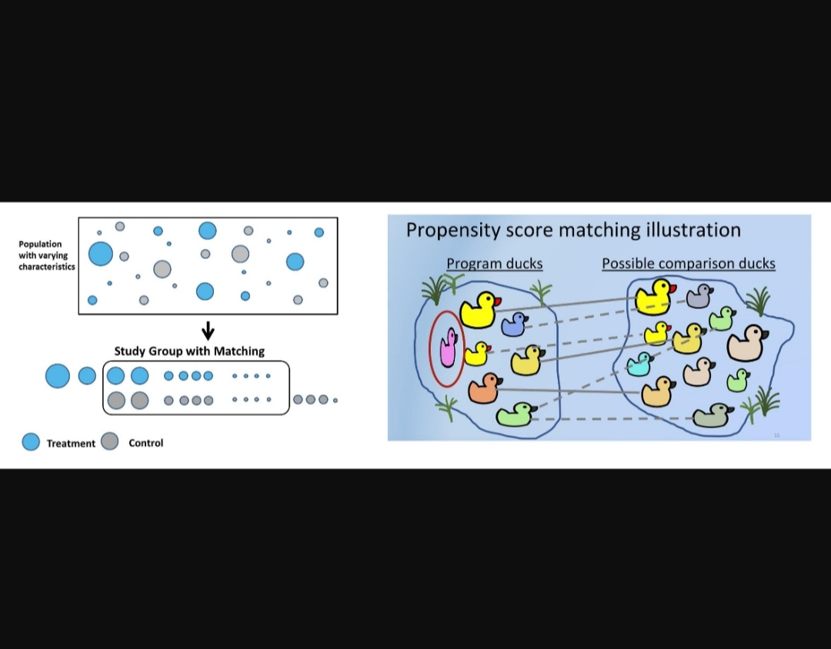

Slide 25
feutures | Barbed suture reinforcement group | Control group
Number of retrieved lymph node | more | less
Surgical time | longer | shorter
Hospital stay | shorter | longer
Estimated blood loss | No difference | No difference
Postoperative ventilation time | No difference | No difference
MOST IMPORTANTLY THE AL INCIDENCE RATES WERE SIGNIFICANTLY LOWER IN INTRCORPOREAL BARBED SUTURE REINFORCEMENT GROUP(2.44%VS 10.57%

Slide 26
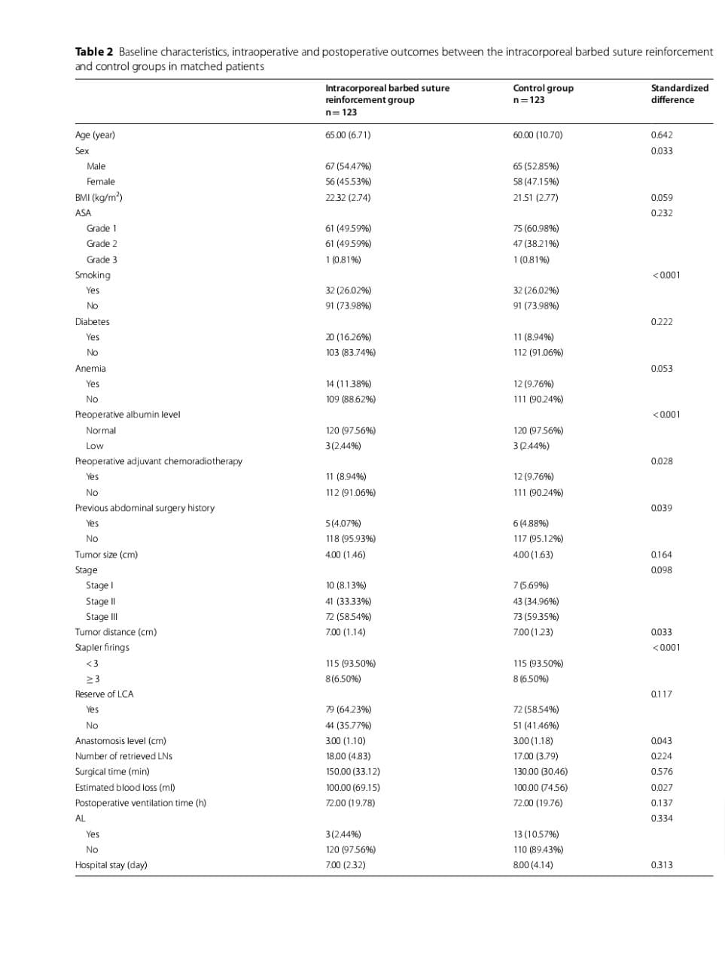

Slide 27
LIMITATIONS IN THE STUDY
This study is a single center retrospective study ad potential biases such as selection bias are in evitable though there are some confounding variables they are reduced by using PSM
And the conclusions from this study are to be cofirmed by randomsiation
So the researchers have said that the randomied control trial can be conducted for furthermore demonstration in the efficacy of reinforcement with barbed sutures

Slide 28
CONCLUSION
As the result the study have found out that the INTRACORPOREAL REINFORCEMENT WITH BARBED SUTURE WAS ASSOCIATED WITH INCIDENCE OF LOW ANASTAMOTIC LEAK AFTER LAPARASCOPIC LOW ANTERIOR RESECTION OF RECTAL CANCER

Slide 29


Slide 30
THANK YOU

