Slide 1
Comparison of digital subtraction angiography combined arterial thrombectomy versus simple arterial thrombectomy in the treatment of acute lower limb ischemia
Journal club presentation
Department of general surgery
Kanyakumari government medical college
Dr. Ganapathy Sitaraman M
General Surgery PG

Slide 2
Hongwei Ge, Bin Song, Xin Wang, Yunfeng Zhu, Yiming Huang, Weibin Huang and Yongbin Zhu
Hongwei Ge and Bin Song contributed equally to this work
Department of Vascular Surgery, The Third Affiliated Hospital of Soochow University, No.185 Juqian Street, Tianning District, Changzhou 213003, Jiangsu, China
Published in July 2021

Slide 3
Introduction
Acute lower limb ischemia(ALI) is a sudden decrease in blood perfusion of lower limbs due to various causes such as embolism and thrombosis vascular occlusion.
The annual amputation rate is as high as 20 to 30% and the annual morbidity of ALI ranges from 1/1000 to 1.5/1000 ,which seriously threatens the survival of patients
ALI is usually associated with 6 ‘P’ signs namely - Pain ,Pallor , Pulselessness , Parenthesis, Paralysis and Poikilothermia

Slide 4
The various treatment modalities available include - arterial thrombectomy and catheter contact thrombolysis (CDT), percutaneous mechanical thrombolysis (PMT) and thrombolytic aspiration
Arterial thrombectomy can remove embolization foci to restore blood supply of limbs, and prevent further injury by limb ischemia in a short time
Along with the popularity of the digital subtraction angiogra-phy (DSA) hybrid operating room, more and more cases receive surgical treatment under DSA at present, which obviously increases the success rate of ALI treatment

Slide 5
Aims and Objectives
This study aimed to compare the clinical efficacy of digital subtraction angiography (DSA) combined arterial thrombectomy versus simple arterial thrombectomy in the treatment of acute lower limb ischemia (ALI).
The differences in the success rate of primary surgery, the second intervention rate, and the amputation/mortality rate within 30-days after surgery were compared
A retrospective cohort study series is presented

Slide 6
Type of study : Retrospective cohort study
Sample Size : 124 patients(128 affected lower limbs)
Study period : March 2010 – November 2019
Inclusion Criteria : Admission of acute non-traumatic disease < 14 days , manifestation of lower limb: pain, pallor, anesthesia, paralysis, pulselessness and artery occlusion confirmed by color doppler ultrasound and computed tomography angiography (CTA).
Exclusion Criteria : Critical limb ischemia (CLI) caused by graft and stent thrombosis and aortic dissection was not included. Also excluded were severe cardiopulmonary dysfunction, coagulation dysfunction, liver and kidney failure which cannot suffer from surgery, advanced malignant tumor

Slide 7
Methods
This retrospective cohort study collected the clinical data from 124 patients (128 affected lower limbs) with ALI who underwent emergency surgery from March 2010 to November 2019. Patients were consecutively divided into Group A and Group B. Patients in Group A underwent simple arterial thrombectomy via the Fogarty catheterization. Patients in Group B underwent arterial thrombectomy, and the DSA was performed during the surgery.
The differences in the success rate of primary surgery, the second intervention rate, and the amputation/mortality rate within 30-days after surgery were compared

Slide 8
Technique
Digital subtraction angiography(DSA)
Digital Subtraction Angiography (DSA) is a fluoroscopic technique that uses complex X-Ray machines to provide clear images of the inner surface of the blood vessels, also called lumen. This technique provides clear picture of the arteries, veins, as well as the four chambers of the heart
The procedure is performed by using a catheter – a small, flexible, narrow tube – which is inserted into an artery in the leg and allowed to flow to up to the blood vessels in the target area. Then a contrasting medium (typically a high density clear liquid) is injected into the catheter, to allow for clear picture of the blood vessels in legs, heart or other organs

Slide 9
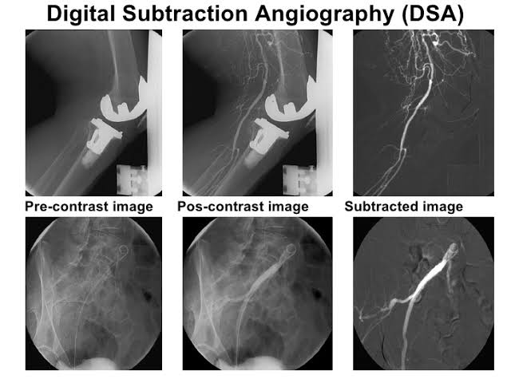
A picture is taken before(mask image) and after the contrast dye is injected; then the first image(mask image) is ‘subtracted’ from the second image – to highlight the blood vessels.

Slide 10
SIMPLE ARTERIAL THROMBECTOMY
Embolectomy and thrombectomy procedures were revolutionized by the introduction of the Fogarty catheter in 1963. This innovation made it possible to extract emboli and thrombi from remote locations through proximal or distal open arterial access. Primary endpoints of success or failure of the original techniques were
(1) the ability to pass the catheter down the arterial segment,
(2) extraction of thrombus, and
(3) the restoration or enhancement of backbleeding at the arteriotomy site
The technique was “blind” in the sense that one had no ability to visualize the extent and location of thrombus. Although results were vastly superior to the historical controls at that time, there were still significant failures such as residual thrombus, as well as iatrogenic injuries from balloon inflation and the repetitive trauma of the balloon shear on the arterial wall causing dissection.

Slide 11
DSA COMBINED ARTERIAL THROMBECTOMY
Addition of fluoroscopy to many operating room environments, and the addition of the guidewire lumen in the Fogarty Double Lumen Embolectomy catheter, make possible a far more controlled, reproducible, and accessible technique for thrombectomy and embolectomy.
The Double lumen Fogarty catheter tip is gently inserted into the orifice of the SFA, and the vessel loop is retightened just enough to prevent bleeding.The fluoroscope is brought into position and, under fluoroscopic guidance, the guidewire is advanced down the SFA and into the distal popliteal artery

Slide 12
Using digital subtraction angiography, an arteriogram of the popliteal and proximal tibial vessels is obtained.
If there is no evidence of acute tibial occlusion (eg: abrupt occlusion of undiseased vessel), the rest of the thrombectomy procedure will then be directed only at the popliteal and SFA.
If there does appear to be thrombus in one or more of the tibials, smaller guidewires and balloons may be chosen to facilitate the selective cannulation of these vessels
If the DSA showed poor blood flow in the outflow tract after the thrombectomy, the catheter was retained for 24–48 h in the artery with residual thrombus fragments.

Slide 13
The following conditions revealed by postoperative DSA should perform the second intervention:
(1) the flow-limiting dissection of the artery formed after thrombectomy;
(2) the potential arteriosclerosis stenosis rate > 50%;
(3) stenting was performed for non-thrombotic arterial dissection;
(4) intracavitary repair with coated stent was performed for limb aneurysms.

Slide 14
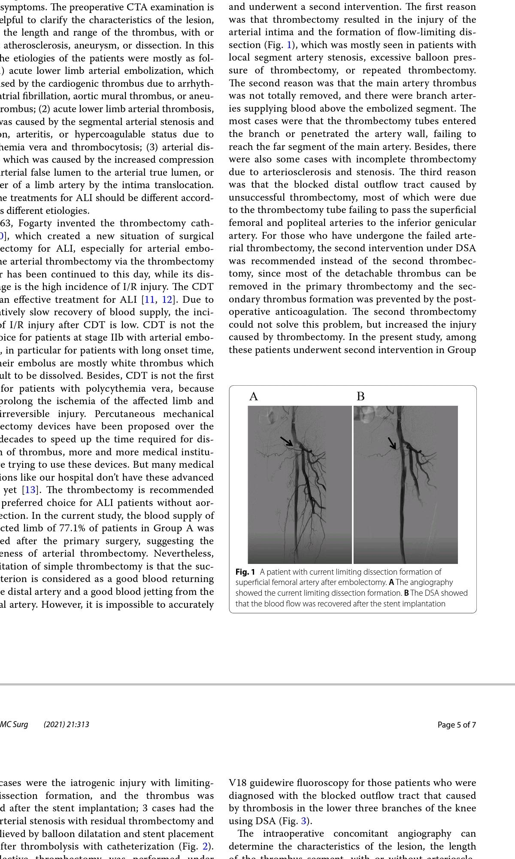
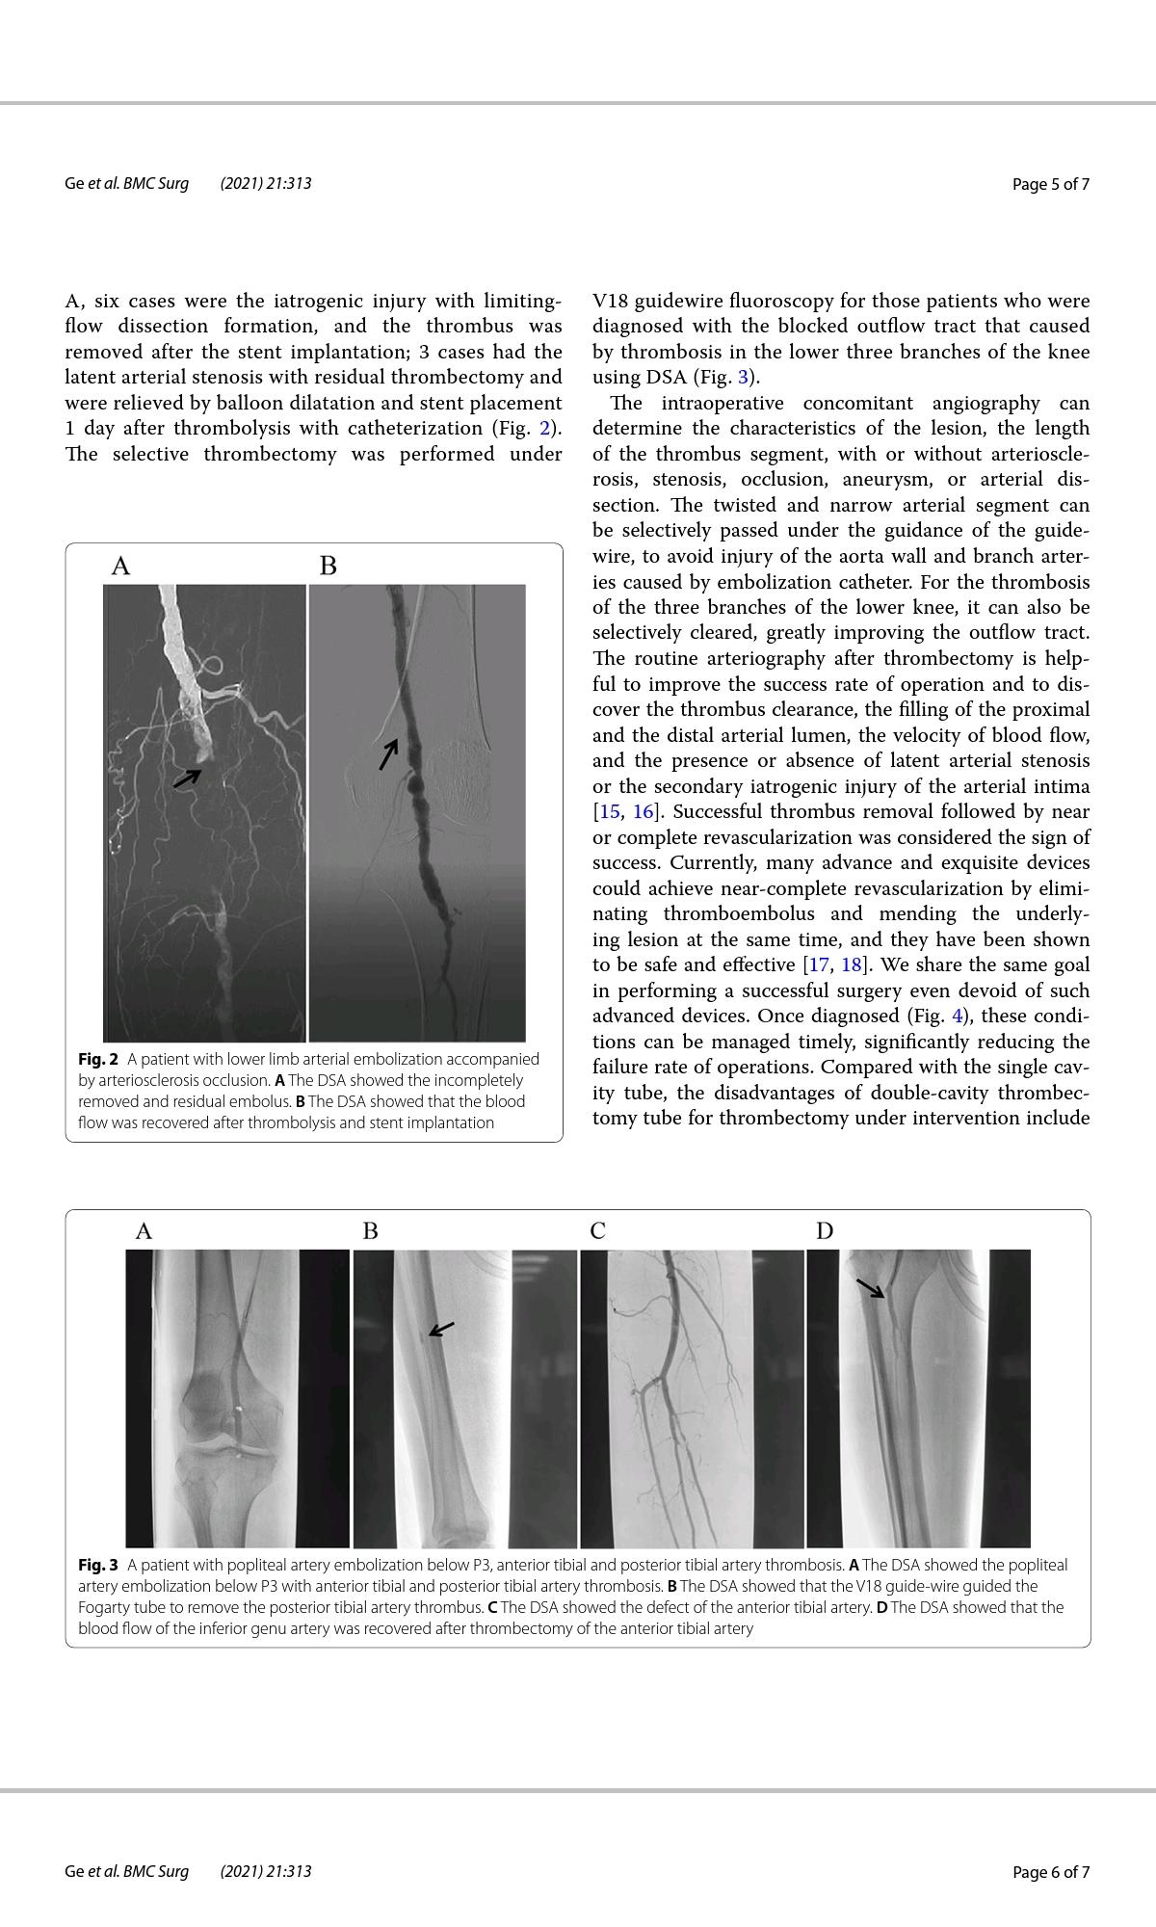

Slide 15
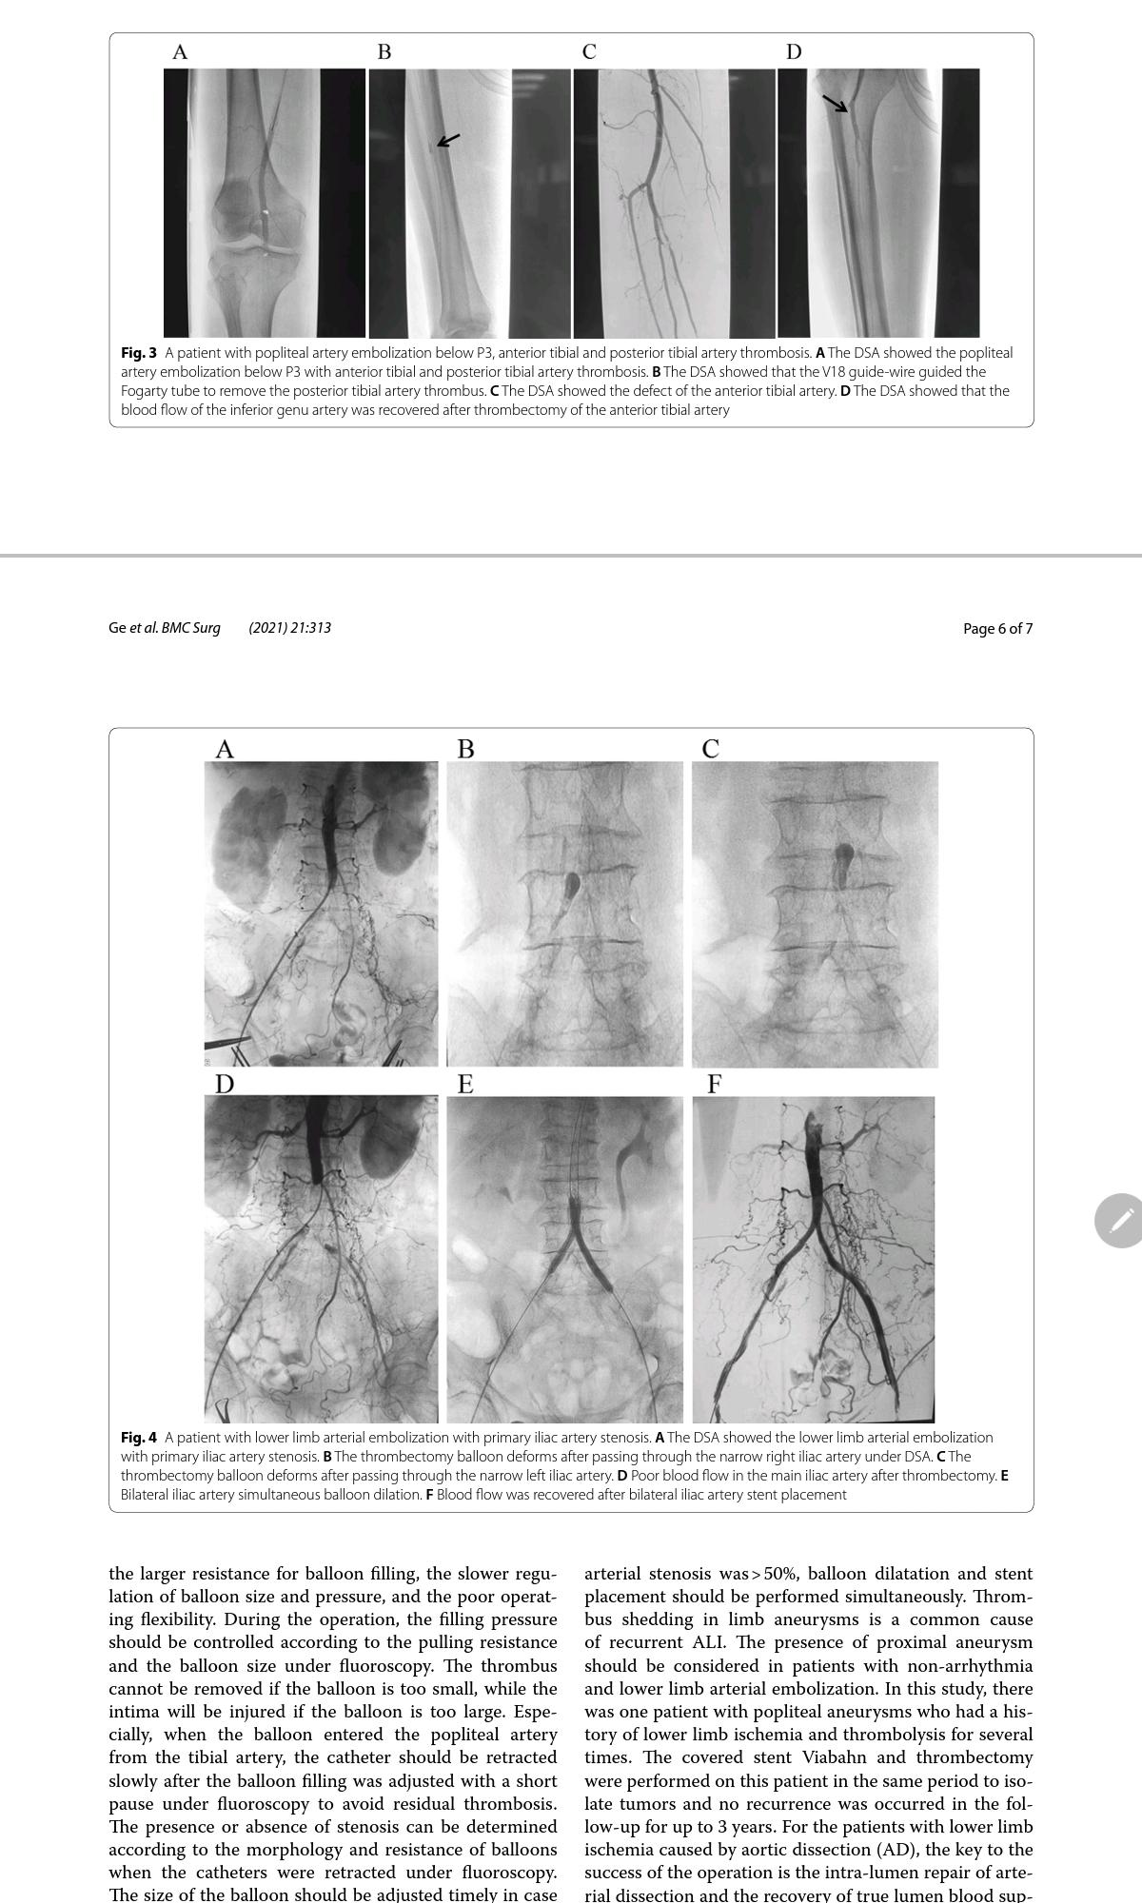

Slide 16
Statistical Analysis
All data were analyzed using SPSS 24.0 software and expressed as a component ratio in this study.
The differences in these parameters between the two groups were compared using the chi-square test.
When comparing the differences in these parameters between the two groups, the t test is used for the continuous numeric data of normal distribution, and the Chi-square test is used for the categorical data. P < 0.05 indicated statistically significant.

Slide 17
Results
In Group A, 4 of 70 limbs (5.7%) were amputated, 54 of 70 limbs (77.1%) had improved blood flow, 14 of 70 limbs (20.0%) received a second intervention, and 3 of 68 patients (4.4%) died within 30 days.
In Group B, 1 of 58 limbs (1.7%) was amputated, 56 of 58 limbs (96.6%) had improved blood flow, 3 of 58 limbs (5.2%) received a second intervention, and 2 of 56 patients (3.5%) died within 30-days.
The success rate of primary surgery, the second intervention rate, and the amputation rate of Group B were significantly lower than Group A (P < 0.05).

Slide 18
Comparison of Secondary intervention rate between two groups
In group A, the blood flows of 16 limbs were not improved or even
re-aggravated after improvement.
The DSA showed that 2 of 16 limbs had residual thrombosis of distal arterioles and a poor outflow tract. After simple catheter thrombolysis, their blood flows were improved and the popliteal pulses were returned to normal after 2–3 days.
The DSA also showed that 6 of 16 limbs had an arterial flow-limiting dissection and another 6 of 16 limbs had severe hardening and narrowing of the arteries. After stent implantation, the blood flows of these 12 limbs were recovered
In Group B, the blood flows of 3 limbs were not improved after the primary surgery. These three patients received a second intervention and 2 of them were improved.

Slide 19
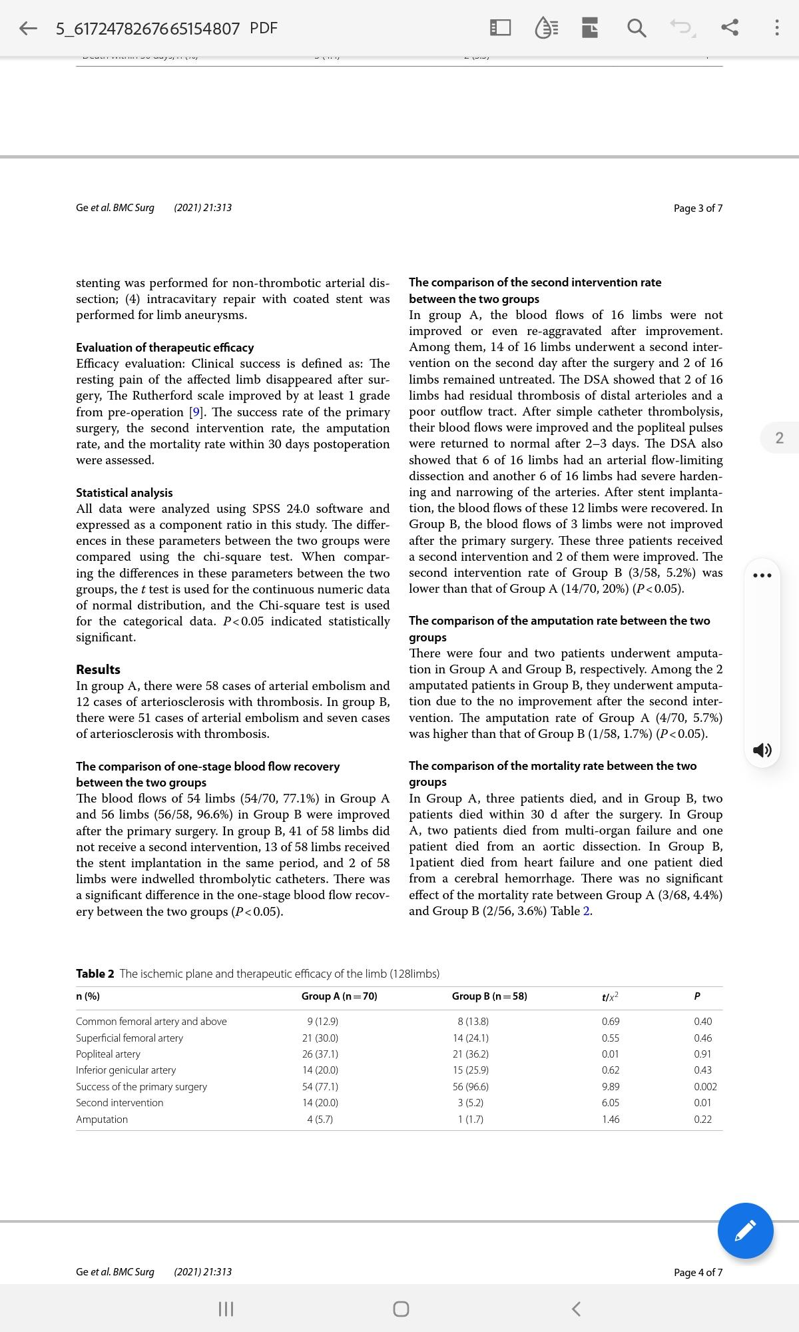

Slide 20
Conclusion
Arterial thrombectomy is an effective surgical method for ALI, and intracavitary interventional therapy is an effective remedy for thrombectomy failures.
The DSA combined arterial thrombectomy may elevate the success rate of operation and reduce the amputation rate.
The long-term follow-up and treatment of the risk factors of secondary ALI, such as organic heart disease-arrhythmia, aneurysm, and atherosclerosis, should be conducted to improve the long-term blood f low and survival rates of patients.

Slide 21
References
1. Alonso-Coello P, Bellmunt S, McGorrian C, et al. Antithrombotic therapy in peripheral artery disease: antithrombotic therapy and prevention of thrombosis, 9th ed: American college of chest physicians evidence-based clinical practice guidelines. Chest. 2012;141(2 Suppl):e669S-e690S.
2.Howard DP, Banerjee A, Fairhead JF, et al. Population-based study of incidence, risk factors, outcome, and prognosis of ischemic peripheral arterial events: implications for prevention. Circulation. 2015;132(19):1805–15.
3.Creager MA, Kaufman JA, Conte MS. Clinical practice. Acute limb ischemia. N Engl J Med. 2012;366(23):2198–206.
4.Gandhi SS, Ewing JA, Cooper E, et al. Comparison of low-dose catheterdirected thrombolysis with and without pharmacomechanical thrombectomy for acute lower extremity ischemia. Ann Vasc Surg. 2018;46:178–86.
5. Gilliland C, Shah J, Martin JG, et al. Acute limb ischemia. Tech Vasc Interv Radiol. 2017;20(4):274–80.
6.Theodoridis PG, Davos CH, Dodos I, et al. Thrombolysis in acute lower limb ischemia: review of the current literature. Ann Vasc Surg. 2018;52:255–62.
7.Parsons RE, Marin ML, Veith FJ, et al. Fluoroscopically assisted thromboembolectomy: an improved method for treating acute arterial occlusions. Ann Vasc Surg. 1996;10(3):201–10.
8.de Donato G, Setacci F, Sirignano P, et al. The combination of surgical embolectomy and endovascular techniques may improve outcomes of patients with acute lower limb ischemia. J Vasc Surg. 2014;59(3):729–36.

Slide 22
9.Rutherford RB. Clinical staging of acute limb ischemia as the basis for choice of revascularization method: when and how to intervene. J Semvascsurg. 2008;22(1):5–9.
10. Obara H, Matsubara K, Kitagawa Y. Acute Limb Ischemia. Ann Vasc Dis. 2018;11(4):443–8.
11. Ebben HP, Yang HT, Hoksbergen AWJ, et al. Catheter-directed thrombolysis for acute limb ischemia in an Asian population. Ann Vasc Surg. 2019;55:246–50.
12. Vakhitov D, Oksala N, Saarinen E, et al. Survival of patients and treatmentrelated outcome after intra-arterial thrombolysis for acute lower limb ischemia. Ann Vasc Surg. 2019;55:251–9.
13. Donatoa G, Pasquia E, Setacci F, et al. Acute on chronic limb ischemia: from surgical embolectomy and thrombolysis to endovascular options. Seminars Vasc Surg. 2018;31:66–75.
14. Pemberton M, Varty K, Nydahl S, et al. The surgical management of acute limb ischaemia due to native vessel occlusion. Eur J Vasc Endovasc Surg: Off J Eur Soc Vasc Surg. 1999;17(1):72–6.
15. Lipsitz EC, Veith FJ. Fluoroscopically assisted thromboembolectomy: should it be routine? Semin Vasc Surg. 2001;14(2):100–6.
16. Lipsitz EC, Veith FJ, Wain RA. Digital fluoroscopy as a valuable adjunct to open vascular operations. Semin Vasc Surg. 2003;16(4):280–90.
17. Lopez R, Yamashita TS, Neisen M, et al. Single-center experience with Indigo aspiration thrombectomy for acute lower limb ischemia. J Vasc Surg. 2020;72(1):226–32.
18. Saxon RR, Benenati JF, Teigen C, et al. Utility of a power aspiration-based extraction technique as an initial and secondary approach in the treatment of peripheral arterial thromboembolism: results of the multicenter PRISM trial. J Vasc Interv Radiol. 2018;9(1):92–100.

Slide 23
Thank you

