Slide 1
JOURNAL PRESENTATION
PRESENTOR- DR. S. A. AJISH JOLLY
UNIT CHIEF AND HOD : PROF. DR. J. A. JAYALAL MS.,FRCS.,PHD
ASSISTANTS: DR. BAGHAVATH MS,
DR. EDWIN KINS RAJ MS.,
DR. GEOLIN MITHUN MS.

Slide 2
Effect of an individualized versus standard pneumoperitoneum pressure strategy on postoperative recovery: a randomized clinical trial in laparoscopic colorectal surgery
Carried out between February 2017 and November 2018.
Paper accepted on 3 May 2020
Published online on 7 June 2020 in Wiley Online Library.
Published by John Wiley & Sons Ltd
BJS Society Ltd 2020

Slide 3
Background:
Its recommended to use lowest possible intra-abdominal pressure (IAP) - acceptable surgical workspace is maintained,
But we use a fixed and usually high IAP ,set between 12 and 15 mmHg, or even higher
Individualization of pneumoperitoneum pressures during laparoscopic surgery -- ?? improves postoperative recovery.
Compared an individualized pneumoperitoneum pressure (IPP) strategy with a standard pneumoperitoneum pressure (SPP) strategy with respect to postoperative recovery

Slide 4
Double-blind two-arm parallel-group multicentre RCT
Four university-affiliated hospitals in Spain
The Institutional Review Board of Hospital Spain approved the study protocol
The study protocol and conduct complied with the Helsinki Declaration and Spanish legislation for biomedical research.
Written informed consent was obtained from all subjects before entering the trial.

Slide 5
INCLUSION CRITERIA
EXCLUSION CRITERIA
Laparoscopic colorectal surgery,
Aged over 18 years,
ASA physical status grade below IV
Without cognitive deficits
Absence of written informed consent
Emergency or unplanned surgery
Pregnancy or breastfeeding
lmmunological or neuromuscular diseases
Advanced stage of cardiopulmonary, renal or hepatic disease
Allergy or contraindications to rocuronium or sugammadex.

Slide 6
RANDOMISATION AND BLINDING
Randomized in a 1 : 1 ratio
Using a web-based automated randomization system.
Randomization was performed with random block sizes and stratified by centre.
Attending anaesthetists – AWARE
Surgeons and patients - Unaware of the assignment at all times, before, during and after surgery.

Slide 7
METHODS - Multicentric RCT
The IPP strategy :
modified patient positioning
deep neuromuscular blockade ,
intraoperative ventilation with a low tidal volume,
abdominal wall prestretching
improve the relationship between IAP and intra-abdominal volume
targeting lowest intra-abdominal pressure (IAP) - acceptable workspace.
The SPP strategy :
patient positioning according to the surgeon’s preference,
moderate neuromuscular blockade
a fixed IAP of 12 mmHg

Slide 8
Pneumoperitoneum strategies
Use of a modified lithotomy position, with the hips flexed ( 45 and 90∘) and legs raised in padded supports to increase the anteroposterior intra-abdominal space by correcting lumbar lordosis;
Deep neuromuscular blockade throughout surgery to maintain a train-of-four (TOF) count of 0 and a post-tetanic count of between 1 and 5, both assessed by acceleromyography at the thumb;
Prestretching of the abdominal wall muscles by maintaining an IAP of 15 mmHg for 5 min at the beginning of carbon dioxide insufflation and insertion of abdominal trocars;
IAP titration from 15 to 12 mmHg, and stepwise to 11, 10, 9 and finally 8 mmHg as long as the attending surgeon maintained an adequate workspace
After the patient had been placed in a 0–30∘ Trendelenburg position;
Neuromuscular blockade reversal at the end of surgery, before tracheal extubation, with 4 mg/kg sugammadex

Slide 9
The SPP strategy
patient positioning according to the surgeon’s preference in the Trendelenburg position (0–30∘);
Moderate neuromuscular blockade with rocuronium, cisatracurium or atracurium throughout surgery to maintain a TOF count between 2 and 4;
IAP set at 12 mmHg throughout surgery;
Neuromuscular blockade reversal, according to usual care with 2⋅5 mg or 30–50 μg/kg neostigmine.
With both , the surgeon could request an increase in IAP if the workspace became inadequate. in steps of 1 mmHg during 1-min intervals until the workspace became adequate, but the IAP was never higher than 15 mmHg;

Slide 10
In both groups,volume-controlled ventilation, using a tidal volume of 8 ml per kg ,
with a 20 per cent inspiratory pause time,
a positive end-expiratory pressure set at 5 cmH2O in patients with a BMI of less than 30 kg/m2 and 10 cmH2O in those with a higher BMI.
Respiratory rate 12 - 15 / min to maintain normal end-tidal carbon dioxide values.
Perioperative analgesia - use of intravenous opioids and NSAIDS
Carbon dioxide insufflation was performed with a standard commercial gas that was neither heated nor humidified.

Slide 11
Primary endpoint:
physiological postoperative recovery
Assessed by means of the Postoperative Quality of Recovery Scale.
Secondary endpoints :
recovery in other domains and overall recovery,
occurrence of intraoperative and postoperative complications,
duration of hospital stay,
plasma markers of inflammation up to postoperative day 3.

Slide 12
The Postoperative Quality of Recovery Scale (PQRS) is a verbal survey tool that assesses recovery in five domains: physiological, nociceptive, emotional, functional and cognitive;
A baseline PQRS score was obtained before surgery.
After surgery, the PQRS score was obtained at 15 and 40 min after arrival in the post anaesthesia care unit, and in the ward during the morning of POD 1 and POD 3.
Overall recovery was defined as recovery in all domains; failure in any domain meant a lack of overall recovery.
Intraoperative adverse events comprised involuntary patient movements, such as diaphragm or abdominal wall contractions, and spontaneous breathing efforts or coughing
Postoperative complications - The Clavien–Dindo classification was used to evaluate the severity of postoperative complications
Blood samples were obtained on POD 1 and POD 3 ,neutrophil–lymphocyte ratio (NLR) and C-reactive protein (CRP) level were measured

Slide 13
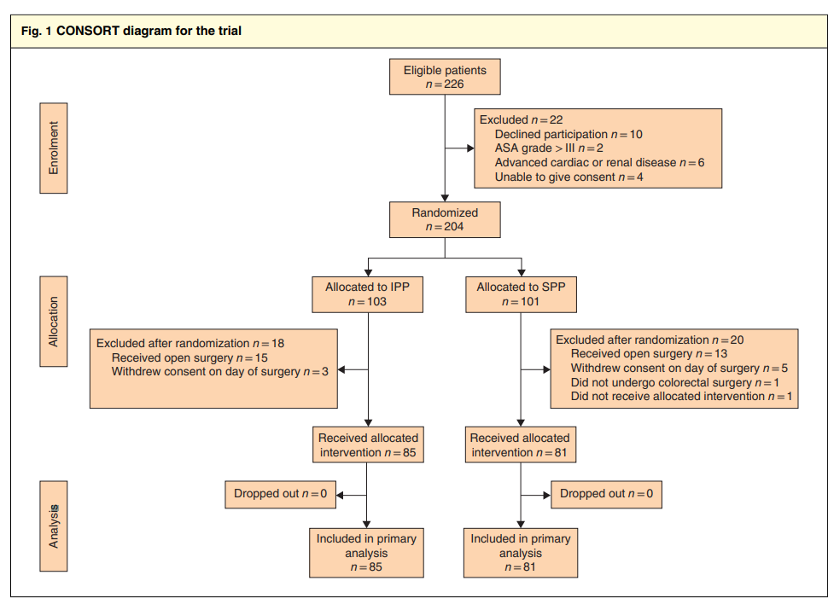

Slide 14
Statistics
The association between the two strategies and the incidence of intraoperative adverse events was assessed by Fisher’s exact tests.
To assess the association between the pneumoperitoneum strategy and duration of hospital stay, a Cox regression model used
Risk Ratios were estimated by modified Poisson regression with robust error variance with sandwich estimator

Slide 15
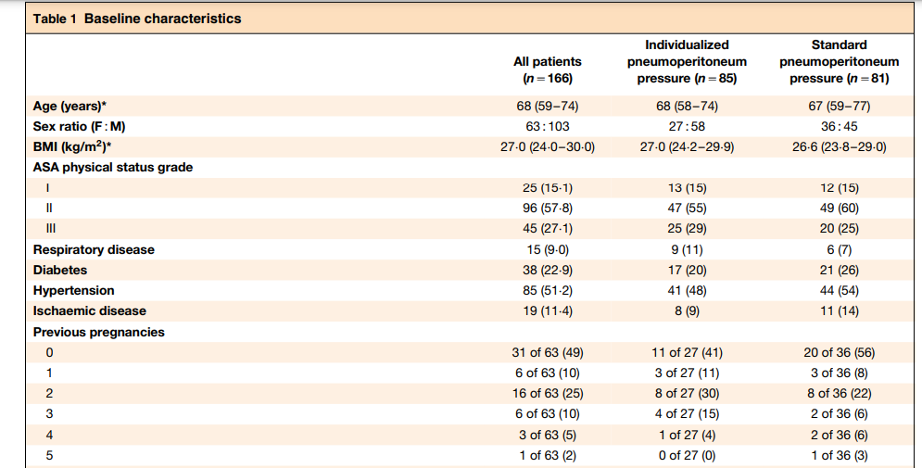

Slide 16
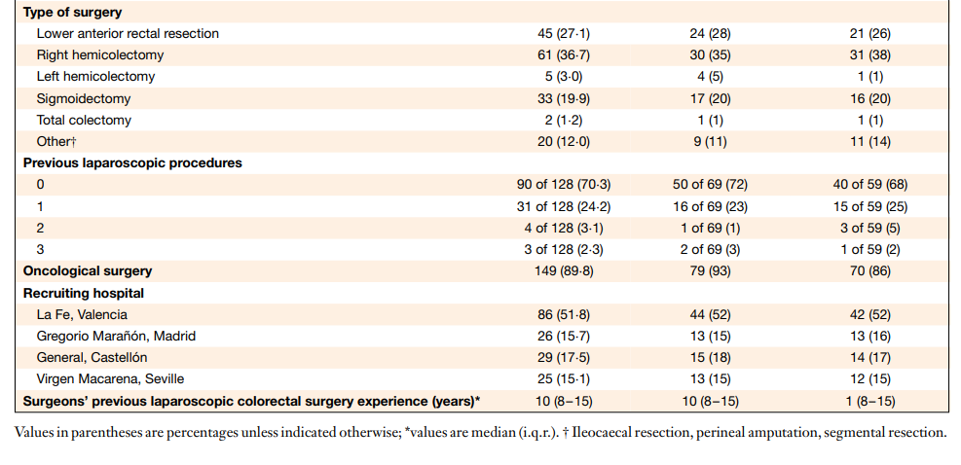

Slide 17
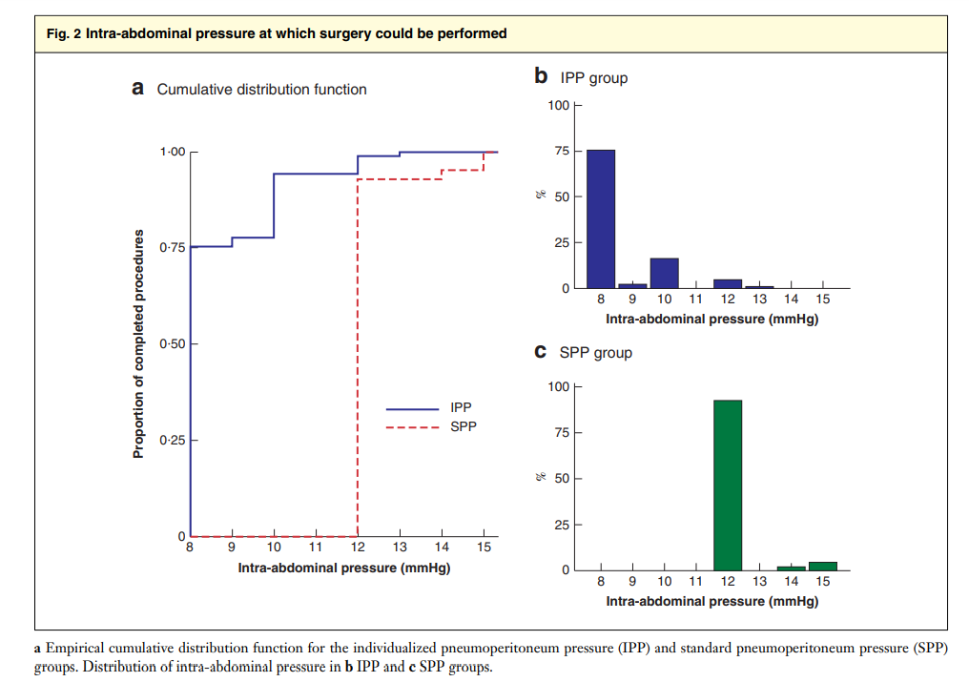

Slide 18
Results
204 patients were included and randomized between February 2017 and November 2018.
38 patients did not receive the allocated intervention.
A total of 166 patients were included .
Baseline characteristics were well balanced and intraoperative characteristics were no different between the two groups .
Follow-up for the primary endpoint was complete up to POD 3, as all patients stayed in hospital for at least 3 days after surgery.

Slide 19
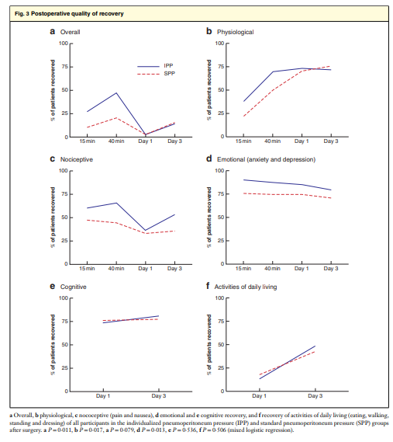

Slide 20
In 80 patients in the IPP group (94 per cent), IAP remained below 12 mmHg during pneumoperitoneum.
A rise in IAP was requested in 20 (24 per cent) and seven (9 per cent) patients in the IPP and SPP group respectively
Patients in the IPP group had a higher probability of physiological and emotional recovery .
nociceptive PQRS score, which was significantly lower in the IPP group
The incidence of intraoperative cough or movement was lower in the IPP group than in the SPP group
The plasma NLR was lower in the IPP compared with the SPP group
No differences were observed in the incidence of postoperative complications or in duration of stay between the two randomized groups.

Slide 21
Strength of study:
tested a previously designed and evaluated IPP strategy that was easy to perform and maintain during surgery, with no deviations from the protocol.
clear separation between the two strategies with respect to the pneumoperitoneum pressure, while keeping sufficient surgical working space with the individualized approach.
The primary outcome was assessed using a previously validated comprehensive scoring system
Patients and surgeons were kept blinded to the group assignment, thereby reducing bias .

Slide 22
Limitations:
The long-term effects of an IPP strategy remain uncertain
considered a restricted number of intraoperative adverse events.
major intraoperative bleeding, and injury to bowel and intra-abdominal organs, were not recorded as part of the present study.
The number of patients recruited was lower than planned, which reduces the statistical power especially to show differences in the secondary outcomes.
The validity of the results among surgical teams with a different level of experience requires further investigation
The study protocol advised postoperative nausea and vomiting prophylaxis but data regarding administration of drugs such as dexamethasone were not collected.

Slide 23
CONCLUSION
IPP Strategy has quicker physiological, emotional and overall recovery in the early postoperative period than a standard strategy.
less intraoperative coughing and movements, and a lower plasma NLR.

Slide 24
THANK YOU

