Slide 1

PERI INGUINAL HERNIAS IN LAPAROSCOPIC ERA

Slide 2
Volume 10 Issue 1 -2022 On MEDCRAVE ONLINE JOURNAL OF SURGERY
AUTHORS:
Weber Sánchez A. Palmisano EM
Department of Surgery, Hospital Angeles Lamas, Mexico
Department of Surgery Hospital Español de Rosario, Argentina
Correspondence: Alejandro Water Sanchez, MD PhD.
Received: July 13, 2022 Published: August 05.2022

Slide 3

Introduction
For more than a century, surgeons have reported hernias that do not correspond to the usual sites in the inguinal and femoral region.
Peri-inguinal hernias are rare hernias; different from indirect, direct inguinal, low Spigelian and other ventrolateral hernias of the abdominal wall.
For that reason, they receive little consideration; and for many surgeons they remain unknown.
Their location around the deep inguinal ring area is variable and therefore the names given to them differ and create confusion.

Slide 4
Laparoscopic vision provides a much broader and clearer perspective that allows visualizing these hernia defects. The purpose of this paper is to report two cases of peri-inguinal hernias solved by laparoscopy, and to review this condition unknown by many surgeons

Slide 5
Methods
A search of the terms “peri-inguinal hernia”, “periinguinal hemia”, “para-inguinal hernia” and parainguinal hernia” was performed in the databases PubMed, SciELO and Medline; supplemented by means of the search engine Google, Yahoo and Wikipedia.
No language or publication restrictions Applied.
They also searched the reference lists of similar cases and review articles.
The papers were analyzed to discriminate and they used only what corresponded to peri-inguinal hernias before writing the manuscript.

Slide 6
Case Report
Case 1:
A 42-year-old female patient with no significant personal or family history, began with pain in the right inguinal region radiating to the right buttock. She also referred paresthesia in the thigh with physical effort. It progressively became intense and constant, until she reported 8/10 on the visual analogue pain scale. She consulted an orthopedist who ruled out a musculoskeletal problem, and later the patient was seen by the surgeons.
Her laboratory tests showed no abnormalities. The ultrasound reported a femoral hernia on the left side and no perceptible hernia defect on the right side. Laparoscopy was performed to repair the femoral hernia and explore the right inguinal region.

Slide 7
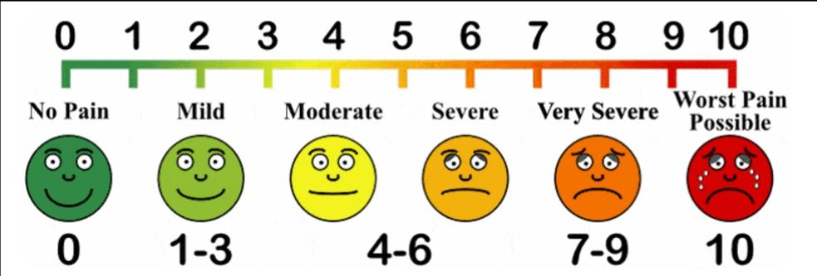
Visual analogue scale for pain:

Slide 8
A TAPP-type (Trans abdominal preperitoneal) dissection of the right inguinal region was performed, finding two hernia holes on the iliopsoas muscle. One 0.3 cm and the other of 0.8 cm, lateral to the psoas muscle, very close to the lateral femoro-cutaneous nerve, both with incarcerated preperitoneal fat. No other hernial orifices were found in the right inguinal, femoral, or obturator region. Herniated preperitoneal fat was released.
An infiltration of anesthetic solution with alcohol as neurolytic was applied, in the muscles of the area.
A polypropylene mesh was applied, closing the peritoneum with running suture. On the left side, the femoral hernia was repaired in the usual Way. The patient reported total relief of the pain. During the follow-up at one week, two weeks, a month, up to six months after surgery she remained asymptomatic.

Slide 9
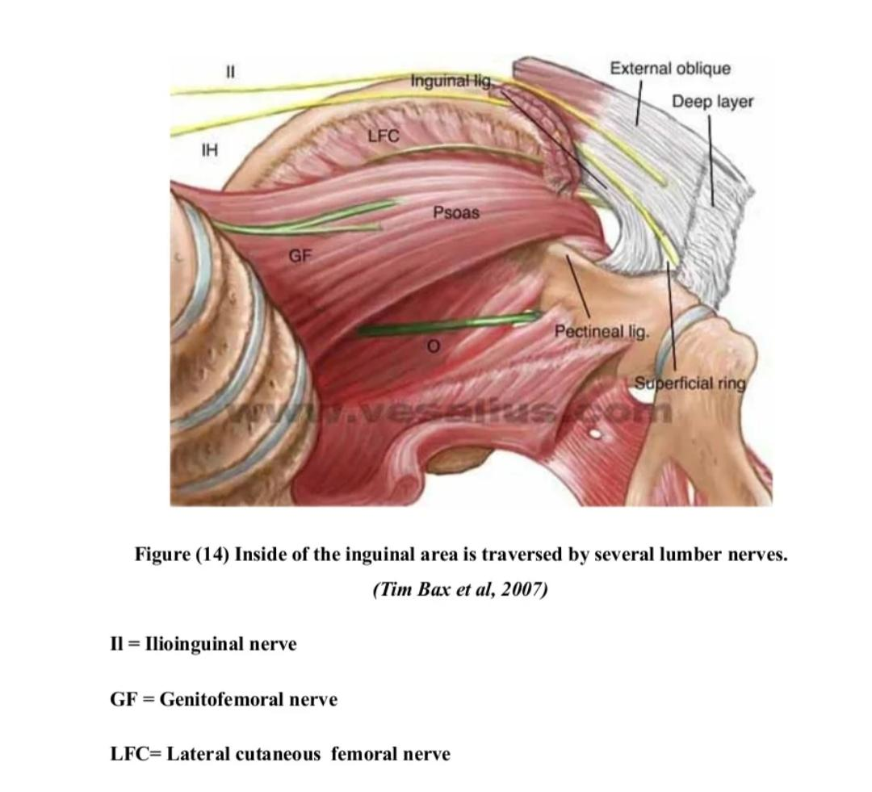

Slide 10
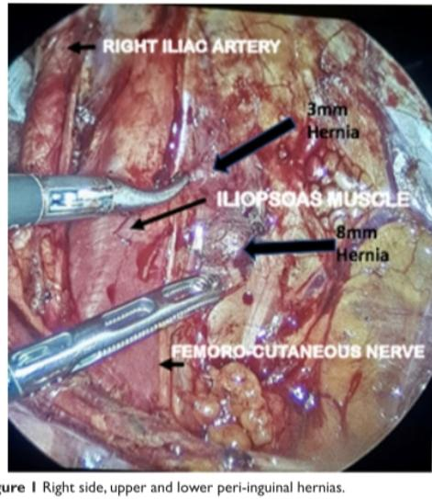

Slide 11
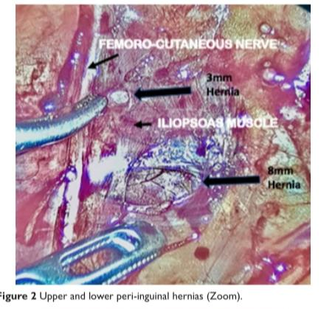

Slide 12
Case 2
A 57-year-old male patient with no significant personal or family history, began with pain in the left inguinal region.7/10 on the visual analogue pain scale. His laboratory tests showed no abnormalities. The ultrasound reported a lateral inguinal hernia.
A TAPP- type dissection was performed, finding one hernia immediately lateral to the internal inguinal hole of 0.3 cm, with incarcerated preperitoneal fat . No other hernia orifices were found in the inguinal, femoral, or obturator region. Herniated preperitoneal fat was released. A polypropylene mesh was applied. Closing the peritoneum in the usual way. The patient reported relief of the pain, from the day after surgery. During the follow-up at one week, two weeks, a month, up to six months after surgery he remained asymptomatic.

Slide 13
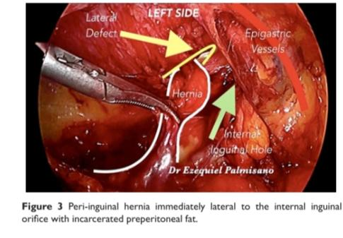

Slide 14
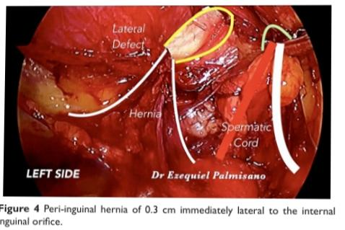

Slide 15
Discussion
This rare type of para or peri-inguinal hernias does not protrude through the usual hernia sites of the inguinal or femoral region, but around these sites through areas that are not naturally crossed by other anatomical structures. One of the first mentions of these hernias, was made by Bruggisser in Berns, in 1858 under the title: Contribution to the parainguinal hernia. He added the subtitle Nobenleistenbruch (lateral break). After this first report, very few cases have been documented since then. Most of them were described in the first half of the 20th century.

Slide 16
Low variants of spigelian
There is a confusion because the different terms given to similar hernias regarding this anatomical area.
Some authors consider them Low variants of Spigel’s hernia. But these hernias of the ventrolateral wall are located in the “Spigelian hernia belt”, the aponeurosis of the transversus muscle delineated by the lateral edge of the rectus muscle medially, and the semilunar (Spigelian) line. They have a precise anatomical location because the weakness of the site, and there are not related to inguinal hernias.
When they are located in the lowest part of this junction, between the rectus, oblique minor and transverse muscles, some authors have named them supra-inguinal hernias.But hernias that originate in the transverse or iliac muscle and are not located on the Spiegel line, but just above or lateral to the internal inguinal orifice, are a different type that should be distinguished from Spigelian and inguinal hernias.

Slide 17
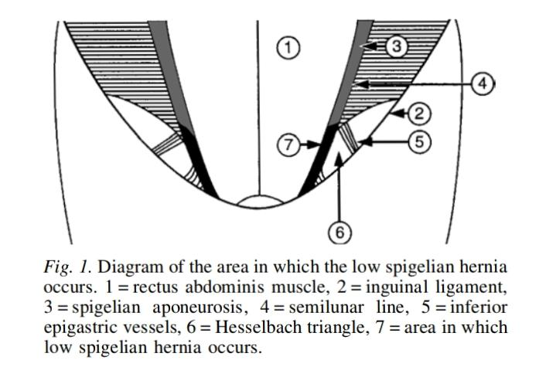

Slide 18
Probably, a sources of confusion comes from the 1746 description of La Chause cited by Holloway “I have considered ventral hernia. Any of the anterior abdominal wall, except femoral, inguinal or umbilical.” Including in his classification parainguinal, medial inguinal, supravesical hernia and hernias at the semilunar line, stating “No certain locus can be assigned to them

Slide 19
A decade ago, the European Hernia Society on a consensus meeting developed a classification for primary and incisional abdominal wall hernias based on a grid format. There was an agreement utilizing position and size as the two variables to name them.
About the location, two midline (epigastric and umbilical), and two lateral hernias (Spigelian und lumbar) were identifiable entities with distinct localizations. So, neither of those correspond to para-inguinal or peri inguinal hernias Besides, none of the classification used for groin hernias, from the original formulated by Harkins, to the latest, include this rare type of peri-inguinal or para-inguinal hernias.

Slide 20
Contributing to this misunderstanding, are the great variety of eponyms given to the hernias of this area. Armas, made a search in the literature finding 31 different types of hernias of the abdominal wall with an eponym, which makes difficult to categorize and remember them. In his search, he found the parainguinal hernia as Bruquiser’s, which may be the same as the one reported by Bruggisser.” Bearing in mind that there are known areas of weakness where abnormal passage of structures can originate, it is not uncommon that hernias can occur virtually anywhere in the muscular abdominal wall.
Not only in the muscles of the anterior abdominal wall and inguinal and femoral orifices, but also, in the transversus and illac muscle as in one of the cases reported here. Its origin could be congenital or acquired. Many of the reported cases of low Spigelian hernias are in pediatric patients. In them, exact location can be even more difficult.

Slide 21
Some authors suggest that they are congenital defects, although there is no evidence to confirm this assertion." Apparently, they are more frequent in males.

Slide 22
Most of the reports are of patients operated by traditional open surgey, which makes the precise identification of the orifice of origin more difficult. However, laparoscopic approach has made possible to appreciate better to the precise origin site,and the defect characteristics.

Slide 23
Finally, another source of confusion is between the terms “para inguinal” or “peri-inguinal that in some papers are used indistinctly.
Gallese, described that both hermias originate adjacent to the inguinal canal, below the semilunar line and below the aponeurosis of the external oblique muscle. But he distinguished between para-inguinal hernias meaning those which penetrate into the inguinal canal, and peri-inguinal hernias for those that cannot be followed into the inguinal canal.But to unify the nomenclature, and avoid confusion, it would be more appropriate to call all these defects as peri-inguinal hernias.

Slide 24
Veréb et al. described the case of a patient with polycystic kidneys, with a hernia located much lower in the anterior abdominal wall. Lateral and cranial to the deep inguinal ring. The hernia had a peritoneal hernia sac with a pre-peritoneal lipoma; it was repaired laparoscopically along with a direct hemia on the other side, and an umbilical hernia.
They performed a literature search using PubMed for the keywords parainguinal hernia, lateral ventral hernia, Spigelian hernia, Spiegel hernia and interstitial hernia, and crossed references. They cited twelve cases since 1904 to theirs in 2015, that fit the diagnosis of this type of defect, but they included two cases of Spigelian hernia. Although scattered may be more cases, because they did not include the term peri-inguinal in their search.

Slide 25
As acute abdomen
Some patients such as the one reported by Cavalaro et al. may present as an acute abdomen.
He reported the case of a 79-year-old man with an intestinal occlusion in whom they found a peri-inguinal hernia in the right iliac region, originated in the transverse muscle, different from Spigel's hernia, with an incarcerated bowel loop. It was repaired by traditional open surgery, labeling it as a ventrolateral wall herniation. The content of these hernias can be variable, usually the content is preperitoneal fat, but visceral structures has also been reported.

Slide 26
Association with other hernial and tissue defects:
These hernias have been described in association with other hernia defects. In some cases, they are associated also with other tissue defects such as polycystic kidneys or aneurysms.
As the case reported by Yokoyama et al. They performed a laparoscopic repair in an emaciated 81-year-old woman with left indirect, right direct, bilateral femoral, bilateral obturator and right Spigelian hernia. They also found a clinically undetected ventral hernia, lateral and cranial to the right internal inguinal ring. This 2 cm Orifice, had fatty tissue Conflicts of interest arising from the retroperitoneal tissue” It is obvious that in this case the patient had herniosis, and the fact that a vessel was going through the orifice, suggests that in patients with this kind of problem any structure piercing the abdominal wall can originate a hernia.

Slide 27
These defects are more difficult to diagnose, not only because of their uncommonness and atypical location, but because their size may be very small and their symptoms unusual, as the cases reported here; so imaging tests may not detect them.
Even with pre peritoneal exploration, it is difficult to locate them.
Veréb had to pinpoint the defect they found in their case, reconstructing the surgical anatomy using an anatomical cadaver model with corresponding land marks.

Slide 28
Sometimes unclear symptoms and a vague tenderness are reported. Instead of a pulpable lump with the classical signs of hernia. In the cases of the patients reported here, they had no palpable mass were the peri-inguinal hernias were located.
The first patient that complained from inguinal pain and numbness of the thigh and pain irradiated to the ipsilateral buttock had the hernia holes very near of the femoro cutaneous nerve. Because of the neuritic pain, we decided to perform also a neural block along with the hernia repair as we usually do in these cases with preoperative neuritic inguinodynia

Slide 29
Patients should be evaluated with image studies. When no hernia is detected by the ultrasound, computed tomography or magnetic resonance imaging scan may have more sensitivity to reveal occult hernias, as the peri-inguinal ones. But if there is diagnostic uncertainty, a laparoscopic approach may be useful to establish a diagnosis and to treat them.

Slide 30
More than a curious matter, this rare type of hernia has therapeutic implications, especially when the patient complains of pain, and no hernia is found. Given their rarity, it is worth to “update the memory” of these defects that more than a century ago were described by meticulous surgeons: because for many surgeons today they are unknown or misinterpreted. Peri-inguinal hernias have clinical implications; they can cause various symptoms, from vague pain to acute symptoms, presenting from childhood to old age.
Laparoscopy can pinpoint the site of origin and provide better repair, since in many cases, they present along with other hernias of the region. The confusion of names and terms makes convenient to refer to them in general as peri-inguinal hernias. As Blaise Pascal said: “We are usually convinced more easily by reasons we have found ourselves, than by those which have occurred to others”.

Slide 31
Conclusion:
Peri-inguinal hernias are a very rare type of hernias different from direct inguinal, low Spigelian and other ventrolateral hernias of the abdominal wall, that present around the deep inguinal ring. There is confusion because their localization and the terminology used to describe them. But they are a reality that should be recognized. Laparoscopy is a useful method to diagnose and treat them.

Slide 32
FundingFunding:
None.
Acknowledgments:Acknowledgments
None.
Conflicts of interest:
The authors of this paper, Alejandro Weber Sánchez, M.D. PhD and Ezequiel M. Palmisano, M.D. declare that they have no conflict of interest.

Slide 33
ADVANTAGES OF THE STUDY :
Case report – a type of descriptive study,in future can be extended to larger studies like systematic review and meta-analysis.
Discussing about rare entity. Not known to many Surgeons and explaining the usefulness of Laparoscopic surgeries over open methods in identifying these hernias.

Slide 34
DISADVANTAGES OF THE STUDY:
1. It’s only a descriptive study not an analytical study.
2. It includes only limited cases,not sufficient for some broad comparison.

Slide 35
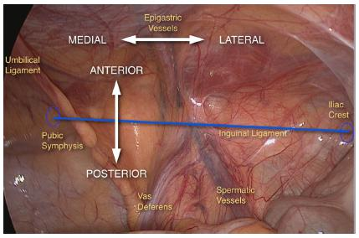
TAPP– Trans AbdominaL Preperitoneal
Anatomy:

Slide 36
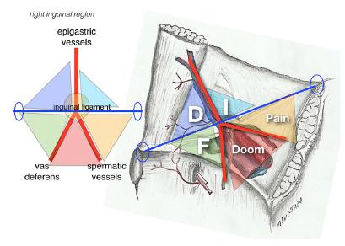

Slide 37
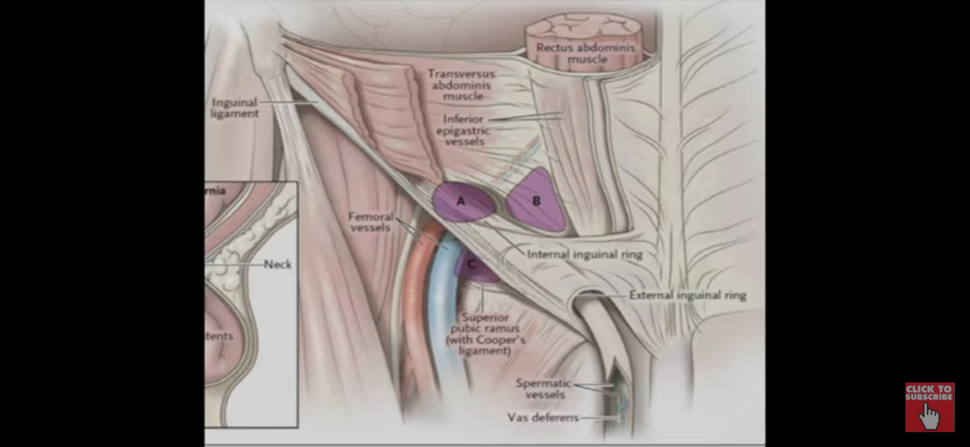

Slide 38
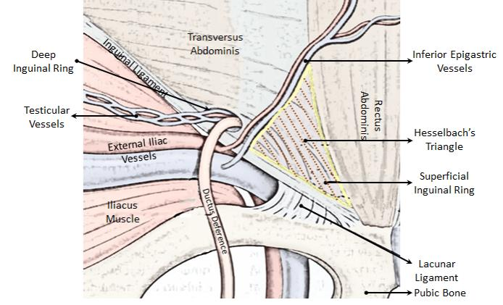
Thank you

Slide 39
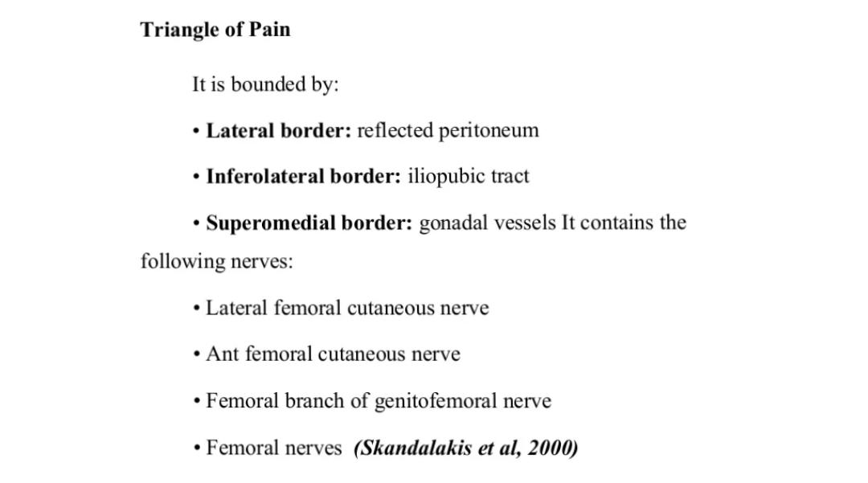

Slide 40
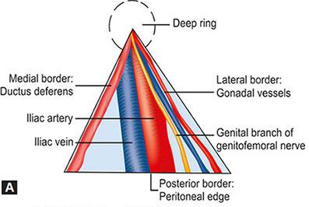
Triangle of doom

Slide 41
Thank you

