Slide 1
Mechanical bowel preparation and oral antibiotics versus mechanical bowel preparation only prior rectal surgery (MOBILE2): a multicentre, double- blinded, randomised controlled trial— study protocol
Dr. Ganapathy Sitaraman M
2nd Year Postgraduate
Department of general surgery

Slide 2
Laura Koskenvuo and Carola Haapamäki
Department of Gastroenterological Surgery, Helsinki University Hospital and University of Helsinki, Helsinki, Finland
Department of Gastroenterological Surgery, Turku University Hospital and University of Turku, Turku, Finland
Department of Gastroenterological Surgery, Tampere University Hospital, Tampere, Finland
Human Microbiome Research Program, Faculty of Medicine, University of Helsinki, Helsinki, Finland
Published in July 2021

Slide 3
Introduction
Mechanical bowel preparation (MBP) prior to rectal surgery is widely used. Based on retrospective data many guidelines recommend mechanical and oral antibiotic bowel preparation (MOABP) to reduce postoperative complications and specifically surgical site infections (SSIs). The primary aim of this study is to examine whether MOABP reduces complications of rectal surgery.
The MOBILE2 (Mechanical Bowel Preparation and Oral Antibiotics vs Mechanical Bowel Preparation Only Prior Rectal Surgery) trial is a multicentre, double- blinded, parallel group, superiority, randomised controlled trial comparing MOABP to MBP among patients scheduled for rectal surgery with colorectal or coloanal anastomosis.

Slide 4
METHODOLOGY
Bowel preparation using MBP and placebo. The MBP is performed using polyethylene glycol (PEG).
The patients drink 2 L of PEG and 1 L of clear fluids of the patient’s choice.
The MBP can be started 2 days before the surgery at 15:00 and must be completed by 15:00 on a day prior to the surgery.
Thereafter, the patients take 1 g of neomycin or placebo orally at 15:00 and 23:00 and 1 g of metronidazole or placebo orally at 15:00 and 23:00.

Slide 5
Patients receive perioperative prophylactic intravenous antibiotics (cefuroxime 1.5 g, metronidazole 500 mg) approximately 1 hour before surgery. The intravenous antibiotics are repeated if surgery is still ongoing 3 hours after the first intravenous dose
Diverting ostomy is used in cases of low colorectal or coloanal anastomosis (<6 cm from anal verge) or if there is leakage in the intraoperative air leak test
The primary aim of this study is to examine whether MOABP reduces complications of rectal surgery

Slide 6
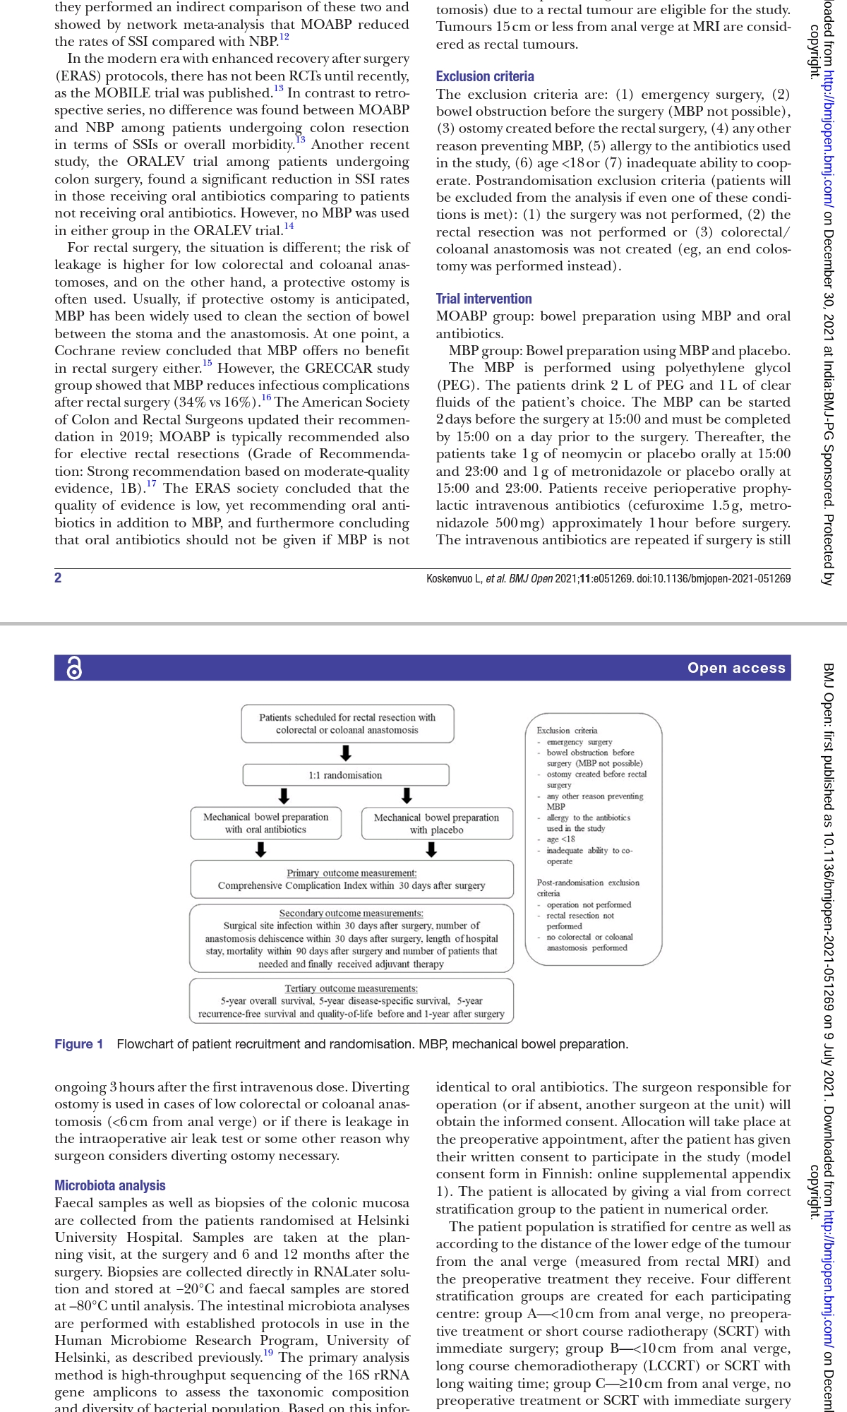

Slide 7
Type of study : Multicentre, double- blinded, parallel group, superiority, randomised controlled trial
Sample Size : 604 patients
Period of Study : Started March 2020
Inclusion Criteria : Patients scheduled for an anterior resection (resection of the rectum and performing colorectal or coloanal anastomosis) due to a rectal tumour are eligible for the study. Tumours 15 cm or less from anal verge at MRI are considered as rectal tumours

Slide 9
RANDOMISATION
The patients are individually randomised 1:1 to MOABP group and MBP group. The randomisation sequence is generated with a computer using variable block size.
Based on the randomisation sequence, antibiotics or placebo are packed at Helsinki University Hospital’s pharmacy’s clinical trials unit in numerically numbered vials, which are grouped based on stratification.
No person outside the pharmacy’s clinical trial unit has access to randomisation sequence or knows whether the vials contain placebo or antibiotics.

Slide 10
STRATIFICATION
The surgeon responsible for operation (or if absent, another surgeon at the unit) will obtain the informed consent. Allocation will take place at the preoperative appointment, after the patient has given their written consent to participate in the study
Four different stratification groups are created for each participating centre:
* Group A—<10 cm from anal verge, no preoperative treatment or short course radiotherapy (SCRT) with immediate surgery;
* Group B—<10 cm from anal verge, long course chemoradiotherapy (LCCRT) or SCRT with long waiting time;
* Group C—≥10 cm from anal verge, no preoperative treatment or SCRT with immediate surgery
* Group D—≥10 cm from anal verge, LCCRT or SCRT with long waiting time.

Slide 11
MASKING
The study is double- blinded. Patients, treating physicians, ward nurses, data collectors and outcome analysers are blinded to the allocated intervention.
Once all the data have been collected and is in the analysis phase, patients will be sorted to groups A and B, but these will not yet be connected to whether the patient received a placebo or antibiotics. Only after the results have been analysed for the main and secondary outcomes will the blinding be completely eliminated

Slide 12
OUTCOMES
The primary outcome is Comprehensive Complication Index (CCI) within 30 days after surgery.
The secondary outcomes are
(1) SSI within 30 days after surgery including superficial SSI, deep incisional infection and organ/space infection,
(2) the number and classification of anastomosis dehiscence within 30 days of procedure,
(3) the length of hospital stay,
(4) mortality within 90 days after surgery (any cause) and
(5) the number of patients who received adjuvant treatment divided by the number of patients that needed it within 6 months of the procedure.

Slide 13
Tertiary outcomes (long- term follow- up) are
(1) 5- year overall survival,
(2) 5- year disease- specific survival,
(3) 5- year recurrence- free survival and
(4) difference in quality- of- life questionnaire (36- Item Short Form Survey (SF-36), Quality of Life Questionnaire Core 30 (QLQ- C30), Quality of Life Questionnaire Colorectal 29 (QLQ- CR29), Low Anterior Resection Syndrome (LARS) scores before the surgery and 1 year after the surgery).
Normal postrectal surgery follow- up will be scheduled. At 6–8 weeks after surgery, the patients will have an abdominal imaging with per rectal contrast medium or, alternatively, a sigmoidoscopy. At this time, it is checked whether the patient has experienced any SSIs, other complications, reoperations or died.

Slide 14
STATISTICS AND DATA ANALYSIS
Sample size was calculated with the aim of showing a difference of 5 CCI points between the groups. The SD is estimated to be 18 in both groups. With a power of 90% and a margin of error of 5%, 574 patients need to be recruited (Willcoxon- Mann- Whitney test). About 5% of patients are estimated to become lost to follow- up, resulting in a final sample size of 604 patients.
Statistical analyses are made with SPSS software.
The primary and secondary outcome will be analysed using either the Mann- Whitney U test or the t-test
Tertiary outcomes will be analysed separately at a later date, when at least 1- year (for QOL) or 5- year follow- up (survival analyses) is available for all patients. Kaplan- Meier and the log- rank test will be used for survival analyses.

Slide 15
MICROBIOTA ANALYSIS
Faecal samples as well as biopsies of the colonic mucosa are collected from the patients.
Samples are taken at the planning visit, at the surgery and 6 and 12 months after the surgery. Biopsies are collected directly in RNALater solution and stored at −20°C and faecal samples are stored at –80°C until analysis.
The primary analysis method is high- throughput sequencing of the 16S rRNA gene amplicons to assess the taxonomic composition and diversity of bacterial population.

Slide 16
DISCUSSION
In the modern era with enhanced recovery after surgery (ERAS) protocols, there has not been RCTs until recently, as the MOBILE trial was published. In contrast to retrospective series, no difference was found between MOABP and NBP among patients undergoing colon resection in terms of SSIs or overall morbidity.
Another recent study, the ORALEV trial among patients undergoing colon surgery, found a significant reduction in SSI rates in those receiving oral antibiotics comparing to patients not receiving oral antibiotics. However, no MBP was used in either group in the ORALEV trial.

Slide 17
For rectal surgery, the situation is different; the risk of leakage is higher for low colorectal and coloanal anastomoses, and on the other hand, a protective ostomy is often used.
The GRECCAR study group showed that MBP reduces infectious complications after rectal surgery (34% vs 16%).
In the retrospective analysis of the 2015 American College of Surgeons National Surgical Quality Improvement Program database comparing the four strategies in (MOABP, oral antibiotics alone, MBP alone, no preparation), MOABP was associated with the greatest risk reduction in SSIs and anastomotic leak when used prior to elective left- sided restorative colorectal surgery with pelvic anastomosis with and without faecal diversion in both laparoscopic and open setting.

Slide 18
STRENGTHS
► No previous large prospective trials
► Appropriate subgroup analyses have been planned according to neoadjuvant treatment and height of the anastomoses.
► Routine postoperative abdominal imaging with per rectal contrast medium
► Analyses of microbiota will provide more data of effects of antibiotics on different bacteria in the colonic mucosa and lumen.
► Reduced Bias
LIMITATIONS
# Limited sample size
# Patient dropout on long term followup

Slide 19
CONCLUSION
While American Society of Colon and Rectum Surgeons recommends using MOABP for all colorectal operations, there is no randomised controlled evidence supporting the recommendation
Although being a large multicentre trial, the study is limited by its sample size, which may not be sufficient for detecting subtle differences in the outcomes or in subgroup analyses.
The study also includes both open and laparoscopic approaches, and results might not be generalisable to other centres where this ratio differs from the trial significantly.
On the other hand, this is a double- blinded placebo- controlled multicenter randomised trial providing the highest level of evidence on the subject.

Slide 20
Thank you

