Slide 1
Perineal resectional procedures for the treatment of compete rectal prolapse:
A systematic review of the literature
Chief:Dr.Bethsy Priscilla MS.,DGO
Asst.Prof:Dr.Vivek MS
Dr.Athisayamani MS
Dr.Dinakaran.M
1st Year post Graduate general surgery.

Slide 2
Department of general surgery, colorectal surgery unit, Mansoura faculty of medicine, Mansoura university, Egypt.
Department of surgery ,Aarhus hospital ,Aarhus, Denmark.
AUTHORS:
Samey hany emile, Hossam elfeki, Mostafa shalaby, Ahmad sakr, Pierpaolo sileri, Steve D. Wexner

Slide 3
AIM AND OBJECTIVES:
The present review aimed to assess the outcomes of the perineal procedures including altemeier, Delorme and perineal stapled resection in the treatment of complete rectal prolapse.

Slide 4
INTRODUCTION
Complete full thickness rectal prolapse is a term that describes the protrusion of the full thickness of rectal wall through the anus. It commonly affects the elderly population and 80-90% are female.
Surgical management of full thickness rectal prolapse can be abdominal and perineal procedures.
The abdominal procedures involve either resection of the sigmoid colon or fixation of the rectum by the sutures or by the use of foreign material such as mesh or sponge.
Perineal procedures either resection altemeier, Delorme and stapled resectional procedures or suspension of the rectum as external pelvic rectal suspension(EXPRESS) procedure.

Slide 5
Methods
Search strategy
The protocol of this review has been registered in the international prospective register of systematic reviews(PROSPERO)
Screening guidelines of the Preferred Reporting Items for Systematic Reviews and Meta-Analyses(PRISMA)

Slide 6
Inclusion criteria
Exclusion criteria
Patients with complete(external) rectal prolapse who underwent perineal resectional procedures
Complete rectal prolapse was defined as full thickness circumferential protrusion of the rectum throughout the anal canal.
Less than 10 patients
Followed patients for less than 12 months
Articles that did not report the recurrence and complications rates

Slide 7
Assessment of methodological quality and bias within the included studies
The revised grading system of the Scottish Intercollegiate Guidelines Network(SIGN)(14) was used to assess comparative studies
National Institute for Health and Clinical Excellence was used for the assessment of cohort studies(NICE)(15)
Variables collected : The primary objective was the clinical recurrence of full thickness rectal prolapse and the secondary objectives included postoperative improvement of bowel symptoms as constipation and fecal incontinence, functional bowel scores, complication and mortality rates, operative time and length of hospital stay

Slide 8
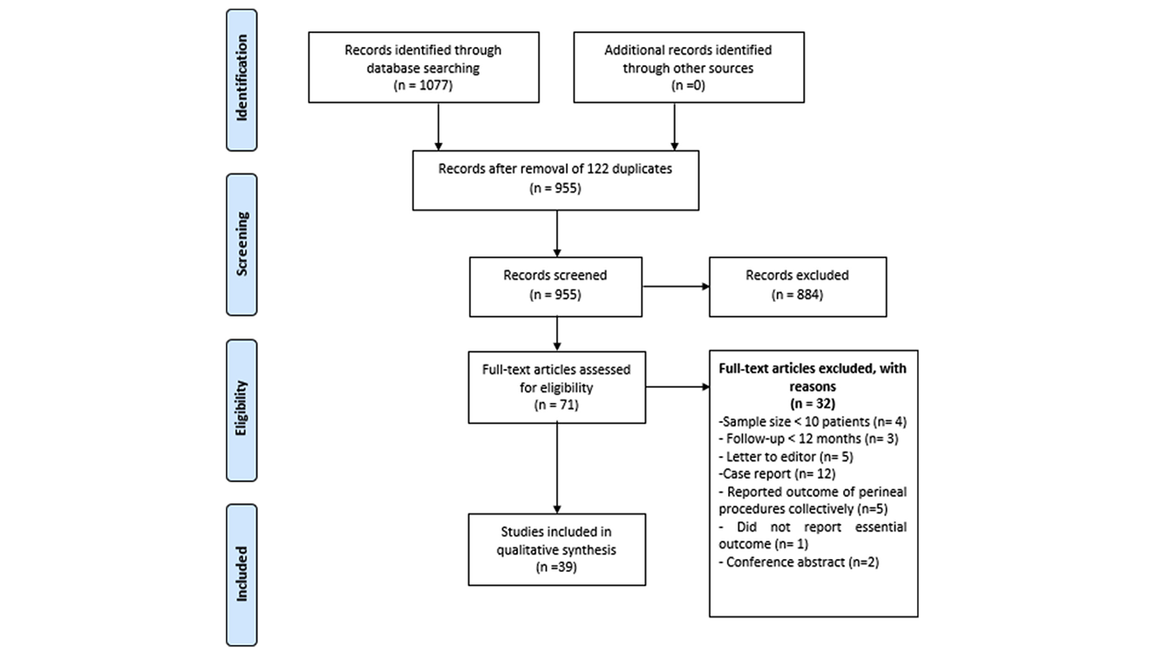

Slide 9
Results
Studies included –after reviewing the full text of 71 articles ,39 of them met eligibility criteria of the review.18 studies evaluated the outcome of altemeier procedure,12 evaluated Delorme procedure,3 assessed both altemeier and Delorme and six studies reported the outcomes of perineal stapled resectional .over all 24-retrospective,11-prospective,4-randomized controlled trials.

Slide 10
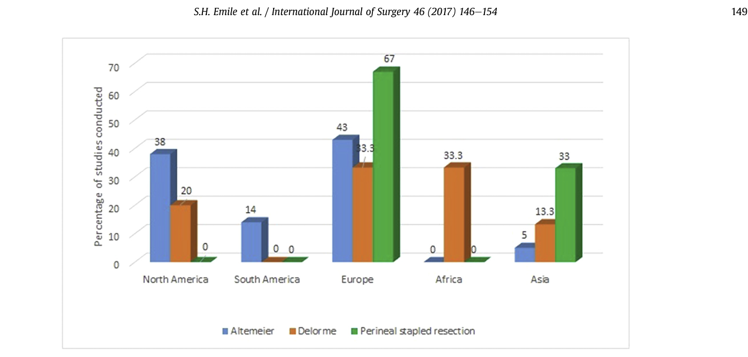

Slide 11
Technical details
The procedures were conducted under general anesthesia-5,spinal/epidural anesthesia-8,either general, regional or local anaesthesia-16.ten studies did not report the type of anaesthesia used.
The altemeier procedure was performed using Hand-sewn anastomosis in 1389((93.3%)and stapled anastomosis in100(6.7%)patients. simultaneously levatorplasty with altemeier procedure was performed in 649(43.5)patients.
Levatorplasty with Delorme procedure was performed in 64(9%)patients.

Slide 12
Altemeier and Delorme procedures had comparable mean operation time and median length of the resected specimen,
whereas Perineal stapled resectional had much shorter operation time and lower median length of the resected specimen (41Vs 96 min ).
Altemeier and perineal stapled procedures had a median hospital stay time of 4.9 and 5 days, compared to 3.5 days for the Delorme procedure.

Slide 13
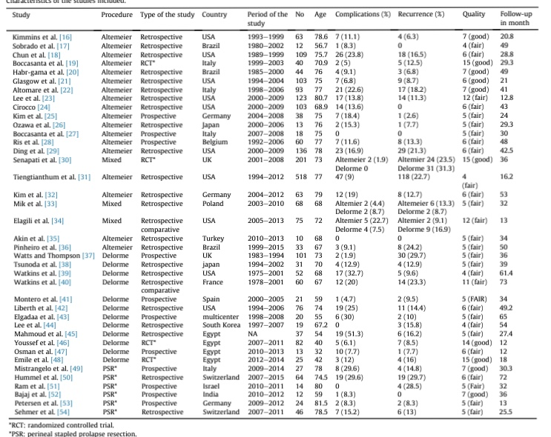

Slide 14
Recurrence
Overall , 411 patients developed recurrence of ful thickness recta prolapse after perineal procedures.Altemeier-275,Delorme- 131,perinea stapled resectional-35
The median incidences of recurrence were
11.4%for altemeier ,
14.4%for Delorme ,
13.9%for perineal stapled resectional.

Slide 15
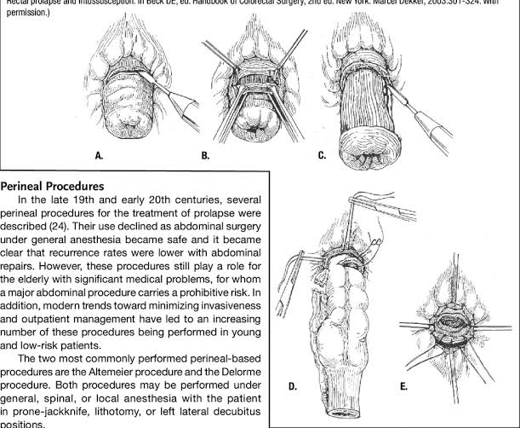

Slide 16
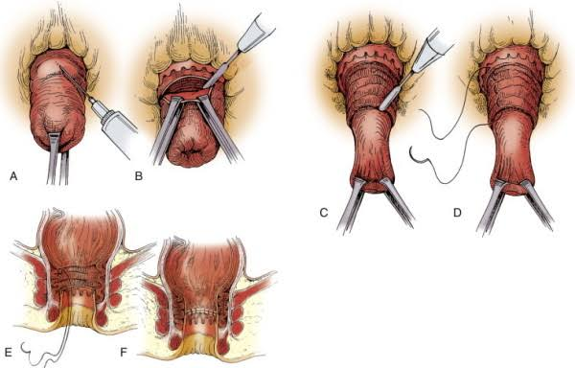

Slide 17
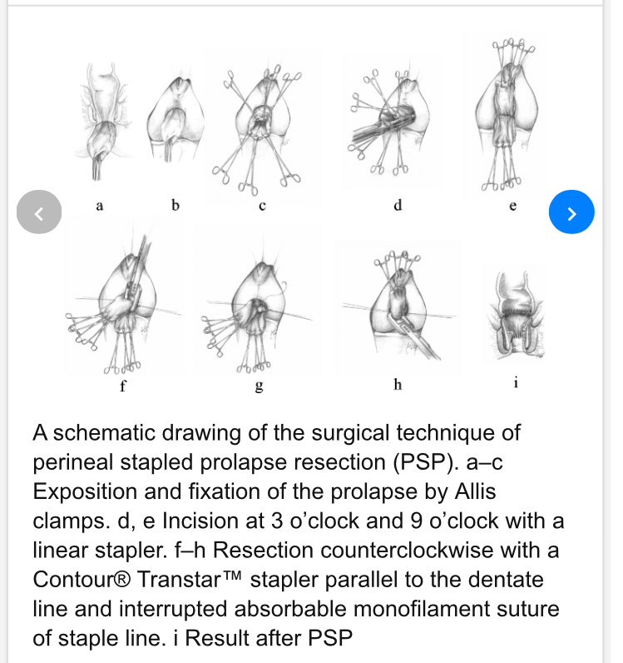

Slide 18
Improvement in bowel symptoms
After each procedure improvement in fecal incontinence
altemeier-61.4%,Deloreme-69%,perineal stapled resectional-23.5%
Improvement in fecal incontinence was more notable in the five studies in which levatorplasty was added to Delorme (78 of 107 patients improved; 72.9%)as compared to the six studies in which the authors did not add levatorplasty (118 of 177 patients improved ;66.6%).As for altemeier procedure the improvement of fecal incontinence was reported only in the studies in which altemeier was combined was levatorplasty whereas the studies in which no levatorplasty was performed did not disclose the functional improvement in continence state, thus the comparison was not possible.
Improvement in constipation altemeier-64.7%,Delorme-59.8%,perineal stapled resectional-64.7%

Slide 19
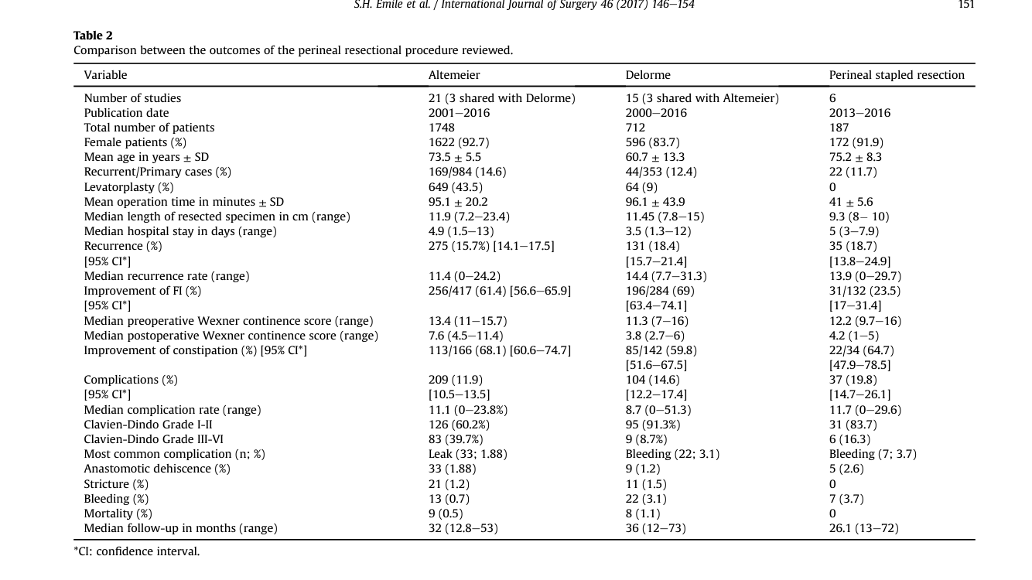

Slide 20
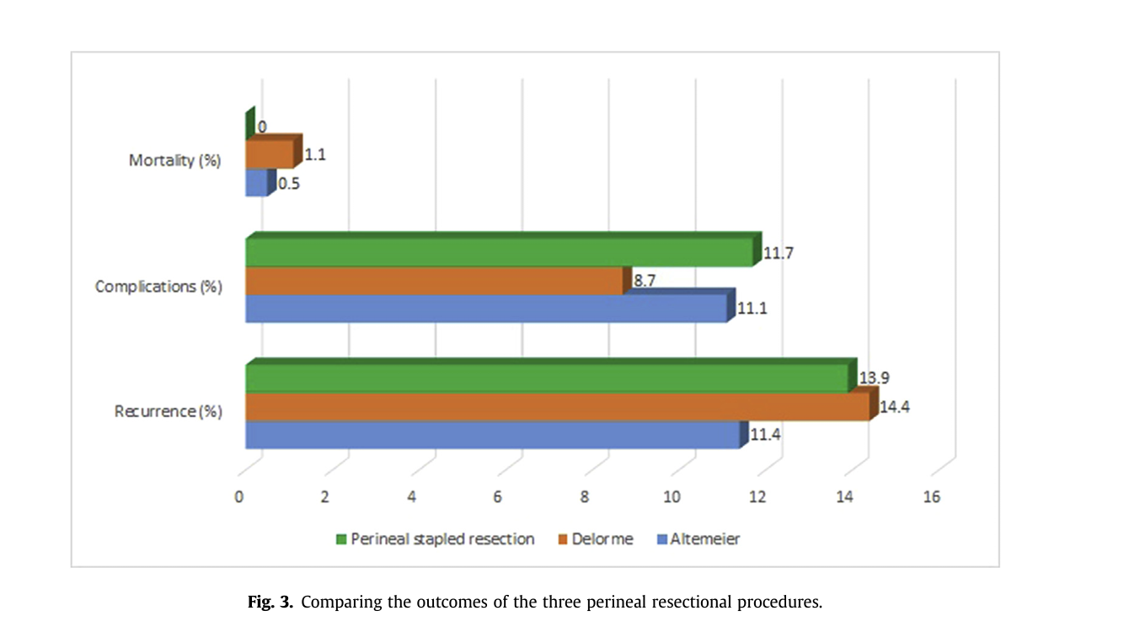

Slide 21
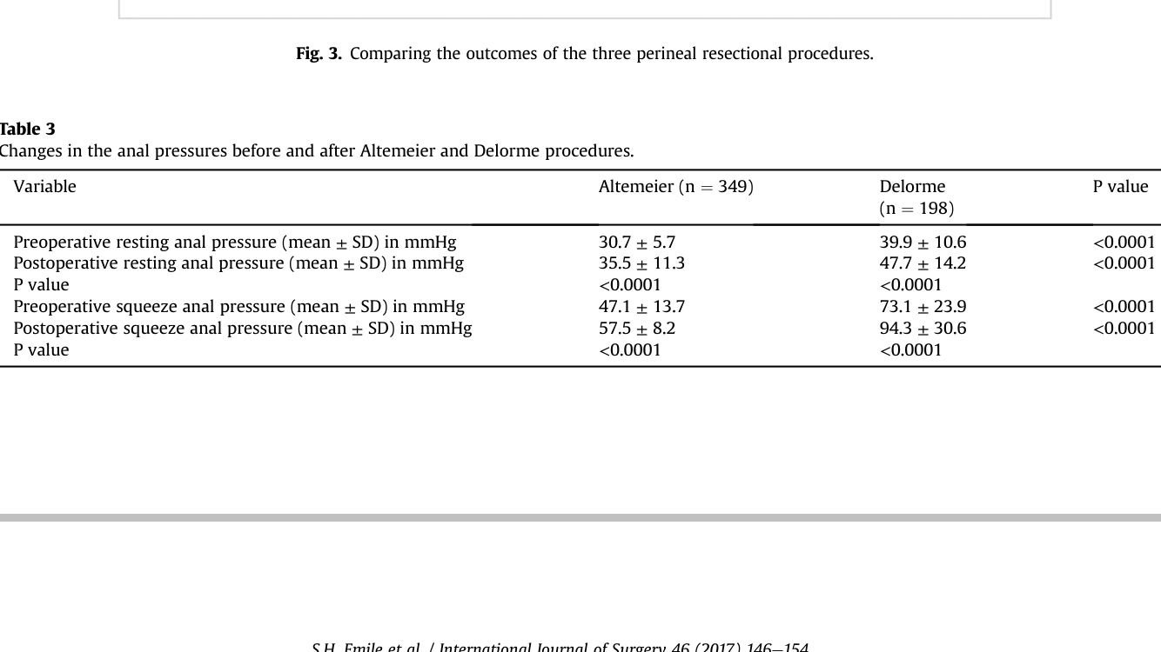

Slide 22
Physiologic parameters
Altemeier procedure, six studies used anal manometry for evaluation of the anal sphincter before and after procedure and one study used pudendal nerve terminal motor latency(PNTML)test.
Two studies employed anal electromyography the assessment of the anal sphincters. both studies have reported an increased duration, polyphasic motor unit potentials in all cases, indicating neurogenic damage in the muscle.
Also, the tonic, voluntary and reflex activity was reduced in all patients, whereas fibrillation potentials, positive sharp waves were observed in 70% of patients in the first study and 77.8%in the second study.
A Paradoxical puborectalis contraction was observed in around half of the patients in both trials .sacral reflex latency was prolonged in 82.5% and 88.9%

Slide 23
Evaluated pudendal nerve terminal motor latency during patients recruitment to exclude patients with pudendal neuropathy from the study .
None of the studies that evaluated perineal stapled resectional used anal manometry or pudendal nerve terminal motot latency for the physiologic assessment of the anal sphincters.

Slide 24
Complications
A total of 350(13.2%; 95% CI: 12-14.5) complications were encountered after perineal resectional procedures. the median rates of complications after altemeier-11.1%,Delorme-8.7%,perineal stapled resectional-11.7%
The majority of complications (n=252; 72%) were of grade I-II on the clavein-Dindo scale of surgical complications. Altemeyer procedure39.7% had higher rate of major complications (grade III-IV) compared to Delorme-8.7%and perineal stapled resectional-16.3%

Slide 25
The most common complications after Altemeyer procedure was anastomotic leakage(1.88%).seven studies that used either manual or stapled technique of Altemeyer reported anastomotic leakage in 8(2.4%) of 337 patients, whereas 14 studies that used manual technique only reported anastomotic leakage in 25(2.2%)
Suture line and stapled line bleeding was the commonest complication after Delorme(3.1%) and perineal stapled resectional (3.7%).

Slide 26
Mortality
17 mortalities(0.64%) were recorded.
9 after altemeier
8 after Delorme
Mortality rates range from 0-3.8% altemeier and 0-5.2% for Delorme
There were no recorded mortalities after perineal stapled resectional

Slide 27
Discussion
Surgery for rectal prolapse abdominal or perineal approaches
The perineal procedures suspension/fixation and trans perineal mesh rectopexy are less frequently described compared to perineal resectional procedures
The resectional procedures altemeier ,Delorme, perineal stapled resectional and stapled trans anal longitudinal posterior proctectomy(STALPP)-external rectal prolapse, stapled trans anal rectal resection(STARR)-internal rectal prolapse

Slide 28
The overall recurrence rate of the perineal procedures was around 16%,much higher than the pooled incidence of recurrence of external prolapse (3.4%)ranging from 1.5to15.4% and internal rectal prolapse (6.5%)after laparoscopic ventral mesh rectopexy.
Altemeier procedure had a slightly lower median recurrence rate than Delorme and perineal stapled resectional. however since no direct statistical comparison has been made ,the superiority of altemeier procedure in terms of recurrence cannot be sustained.
Recurrence of rectal prolapse after perineal approach can be substantially higher with longer follow-up
Unlike Delorme operation, altemeier procedure entails full thickness recto sigmoidectomy which better prevents recurrence than simple mucosal resection.

Slide 29
The improvement of bowel function is also an important parameter of the effectiveness of the procedure. The improvement in the continence was around altemeier 60%,Delorme 70%,perineal stapled resectional less than 25%.
Indeed , a randomized trial has clearly demonstrated that the addition of levatorplasty to Delorme procedure did not only improve fecal incontinence, but also improve preoperative constipation and decrease the incidence of recurrence significantly more than Delorme procedure alone.
All of the perineal resectional procedure conferred a significant improvement of constipation 59-68%of the patients with the highest improvement achieved by the altemeier procedure.
Few studies employed physiologic assessment of the anorectal functions after perineal procedures. Significant increase in the resting and squeeze anal pressure and slight decrease in the pudendal nerve terminal motor latency(PNTML)

Slide 30
The perineal resectional procedures were comparable regarding the technical aspects, perineal stapled resectional shorter operation time whereas Delorme had a shorter hospital stay.
Another potential advantage is the feasibility to perform perineal procedures using different type of anaesthesia according to the general condition of the patient, whereas abdominal procedures are usually performed under general anaesthesia.
Approximately 13% of the patients developed complications after perineal resectional procedures and less than 20% of the recorded were major complications,Delorme-9%, altemeier and perineal stapled resectional around 11%
The most common complications of altemeier was anastomotic dehiscence and leak.

Slide 31
Suture and staple line bleeding was the most common complication after Delorme and perineal stapled resectional procedure which necessitate longer hospitalization of the patient that reached up to 12 days in one report .
Other unique complications were recorded as stapler malfunction and entanglement the posterior vagina wall during perineal stapled resectional.
In summary, abdominal procedures are associated with much lower recurrence rate and high morbidity rates than the perineal procedures.
According to a recent retrospective study of 231 patients, laprascopic ventral mesh rectopexy had a recurrence rate of 11.7%,close to that of altemeier and slightly lower than the median incidence of recurrence for Delorme and perineal stapled resectional.

Slide 32
Since the perineal stapled resectional procedure was recently introduced in the management of rectal prolapse, the number of studies and patients included was much lower than the other two established techniques.
Hence, the outcome of perineal stapled resectional should not be compared directly with altemeier and Delorme procedures since perineal stapled resectional is still in the stage of technical adoption.

Slide 33
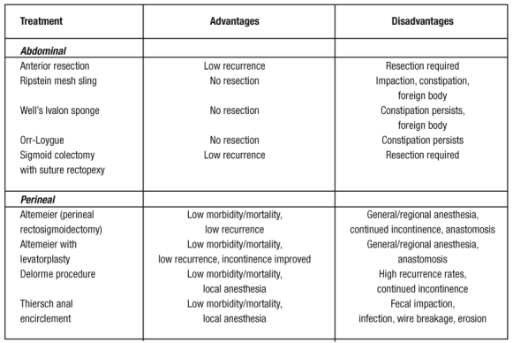

Slide 34
Conclusion
Perineal resectional procedures were followed by a relatively high incidence of recurrence ,yet an acceptably low complication rate. They also achieved satisfactory in bowel function which was paralleled by similar improvement in physiologic anorectal functions.
Definitive conclusions on the superiority of one procedure over another regarding recurrence and complication rates and functional outcome cannot be reached due to the significant heterogenicity of the studies and relatively short follow-up.

Slide 35
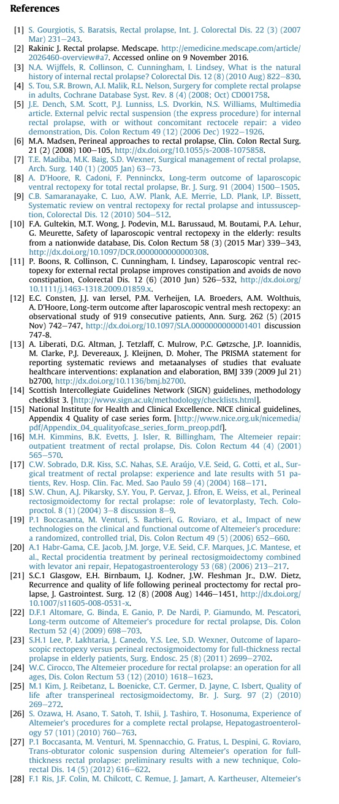
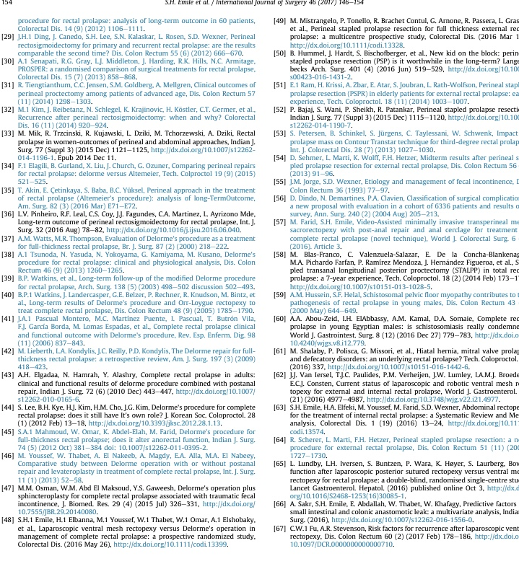

Slide 36


