Slide 1
Segmental resection of splenic flexure colon cancers provides an adequate lymph node harvest and is a safe operative approach – an analysis of the ACS-NSQIP database
Review By
Dr Ajeet Shukla
1st year post graduate Depart.Of Gen.Surgery
HOD &CHIEF-
PROF. Dr J.A.Jayalal MS.FRCS.PhD
ASSIS.PROFESSORS-
Dr Edwin Kins Raj MS
Dr P.R.Baghavath MS
Dr.J.Geolin Mithun MS

Slide 2
INTRODUCTION
The goal of this study was to compare lymph node harvest and post-operative morbidity between segmental resection and formal left hemicolectomy for splenic flexure colon cancers.
Fewer than 10% of colon cancers are found at the splenic flexure.
SFCs are defined as tumors located within 10 cm of the splenic flexure edges or as arising from the colon between the distal third of the transverse colon and the proximal third of the descending colon.

Slide 3
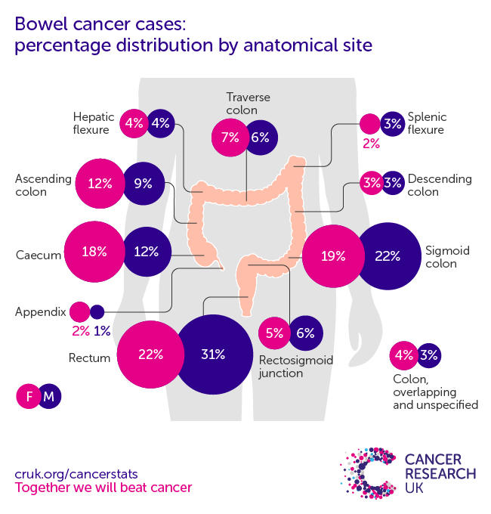

Slide 4
SFCs are defined as tumors located within 10 cm of the splenic flexure edges or as arising from the colon between the distal third of the transverse colon and the proximal third of the descending colon.
A standard surgical approach to these cancers has not been defined.
The current literature seems to suggest that a more limited colon resection is indeed safe and can still provide adequate oncologic outcomes.

Slide 5
MATERIAL AND METHODOLOGY
STUDY DESIGN:Descriptive study (retrospective study was performed using ACS-NSQIP Program)
STUDY PERIOD:-2012 -2018 In North America.
STUDY POPULATION:- Patients ≥ 18 years of age were identified from the study period ACS-NSQIP colectomy-targeted patient user file (PUF).

Slide 6
INCLUSION CRITERIA:-
patients who had undergone an elective surgery for a malignant neoplasm of the splenic flexure for which nodal harvest results were available.
Patients with descending colon cancers.
Only patients that had data in both the general and colectomy PUFs were included in the study.
EXCLUSION CRITERIA:-
Transverse colon cancers.
All emergency cases were excluded.

Slide 7
OUTCOME
The primary outcome was adequacy of lymph node harvest (≥ 12 nodes) as a quality indicator for oncologic resection.
The secondary outcomes studied were post-operative major morbidity and operative time

Slide 8
STATISCAL ANALYSIS
Categorical data were reported as frequencies and percentages.
Continuous data were reported as means and standard deviations.
Analysis of differences was performed by a two-tailed Student’s t test for continuous variables and
A Pearson’s chi-square test for categorical variables.

Slide 9
RESULTS
Demographic and clinical characteristics of the study population.
Tumor pathology and operative approach.
Oncologic outcomes.
Post-operative outcomes

Slide 11
DEMOGRAPHIC AND CLINICAL CHARECTERISTIC
n (%) or mean (SD) | Left hemicolectomy (partial colectomy with colorectal anastomosis) | Splenic flexure resection (segmental colectomy with colocolonic anastomosis) | p-value
Total population | 499 (16.37) | 2550 (83.63) | –
Age | 64.5 ± 13.3 | 64.8 ± 13.0 | 0.648
Male sex | 259 (51.9) | 1397 (54.7) | 0.257
Race |  |  | 0.257
White | 339 (67.9) | 1675 (65.6)
Black or African American | 63 (12.6) | 290 (11.3)
Other | 97 (19.4) | 585 (22.9)
ASA* |  |  | 0.123
I | 6 (1.2) | 47 (1.8)
II | 197 (39.4) | 1030 (40.3)
III | 3265 (53.1) | 1342 (52.6)
IV | 29 (5.8) | 125 (4.9)
Smoking | 47 (9.4) | 328 (12.8) | 0.038
BMI (kg/m²)* | 29.5 ± 6.5 | 29.3 ± 6.8 | 0.527
Diabetes |  |  | 0.999
no insulin | 68 (13.6) | 359 (14.0)
insulin | 30 (6.0) | 159 (6.2)
Hypertension | 263 (52.7) | 1417 (55.5) | 0.259
CHF* | 1 (0.2) | 21 (0.8) | 0.224
COPD* | 28 (5.6) | 121 (4.7) | 0.479
Bleeding disorder | 12 (2.4) | 58 (2.2) | 0.988
> 10% weight loss | 25 (5.0) | 79 (3.0) | 0.043

Slide 12
TUMOR PATHOLOGY AND OPERATIVE APPROACH
n (%) or mean (SD) | Left hemicolectomy (partial colectomy with colorectal anastomosis) | Splenic flexure resection (segmental colectomy with colocolonic anastomosis) | p-value
Total population | 499 (16.37) | 2550 (83.63) | –
Pathologic T-stage |  |  | 0.703
T0 | 8 (1.6) | 43 (1.6)
Tis | 1 (0.2) | 14 (0.5)
T1 | 64 (12.8) | 288 (11.2)
T2 | 74 (14.8) | 340 (13.3)
T3 | 260 (52.1) | 1349 (52.9)
T4 | 62 (12.4) | 330 (12.9)
Pathologic N-stage |  |  | 0.429
N0 | 288 (57.7) | 1440 (56.4)
N1 | 111 (22.2) | 626 (24.5)
N2 | 51 (10.2) | 289 (11.3)
Operative approach (open vs. other) | 143 (28.6) | 695 (27.2) | 0.563
Laparoscopic converted to open | 46 (9.2) | 215 (8.4) | 0.625
Robotic | 56 (11.2) | 227 (8.9) | 0.121

Slide 13
ONCOLOGIC AND POSTOPERATIVE OUTCOME
n (%) or mean (SD) | Left hemicolectomy (partial colectomy with colorectal anastomosis) | Splenic flexure resection (segmental colectomy with colocolonic anastomosis) | p-value
Total population | 499 (16.37) | 2550 (83.63) | –
Nodal harvest (< 12 lymph nodes) | 37 (7.4) | 234 (9.1) | 0.130
Lymph nodes harvested | 21.1 ± 12.2 | 19.4 ± 9.8 | 0.0078
Anastomotic leak | 20 (4.0) | 96 (3.7) | 0.486
Bleeding | 34 (6.8) | 182 (7.1) | 0.871
Surgical site infection | 19 (3.8) | 109 (4.2) | 0.723
Deep organ space infection | 20 (4.0) | 87 (3.4) | 0.596
Septic shock | 4 (0.8) | 31 (1.2) | 0.572
Myocardial infarction | 3 (0.6) | 15 (0.5) | 0.999
Acute renal failure | 2 (0.4) | 6 (0.2) | 0.855
Pneumonia | 5 (1.0) | 44 (1.7) | 0.326
Deep vein thrombosis | 3 (0.6) | 25 (1.0) | 0.724
Pulmonary embolism | 4 (0.8) | 20 (0.7) | 0.999
Mortality | 2 (0.4) | 19 (0.7) | 0.579
**Major morbidity | 42 (8.4) | 229 (8.9) | 0.750
Operative time (mins.) | 213.3 ± 83.5 | 192.9 ± 84.1 | < 0.001
Length of stay (days) | 5.3 ± 4.3 | 5.4 ± 4.5 | 0.805
Re-operation | 24 (4.8) | 96 (3.7) | 0.331
Re-admission | 39 (7.8) | 214 (8.3) | 0.339

Slide 14
DISCUSSION
The adequacy of lymph node harvest and results of post-operative morbidity were compared between two different surgical interventions:
Our study showed a segmental colectomy for SFC provides an oncologically adequate lymph node harvest and does not lead to any worse morbidity.
Segmental colectomy offered the additional benefit of having a shorter operative time.

Slide 15
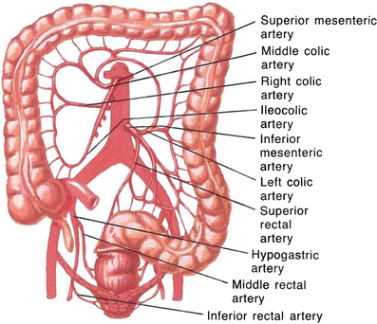
Surgical anatomy

Slide 16
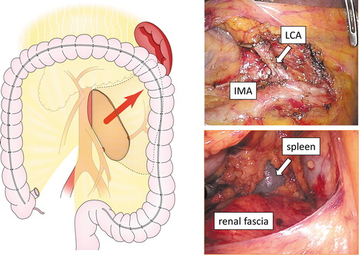

Slide 17
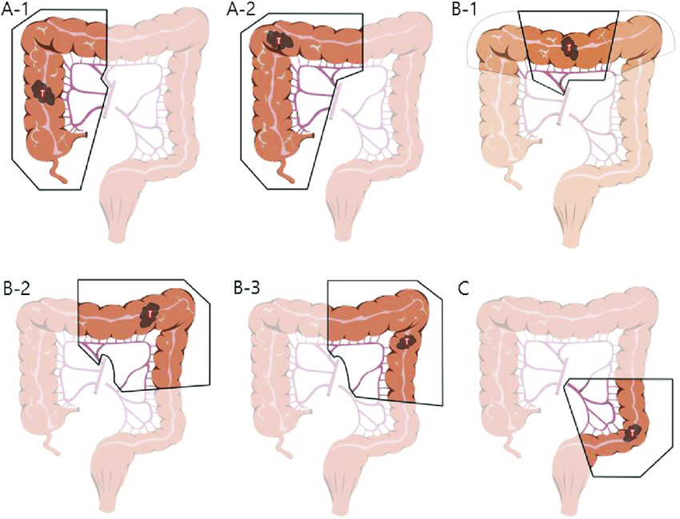
(A) right hemicolectomy (A-1) and extended right hemicolectomy (A-2) were included. In ther group (B) transverse colectomy (B-1, note that light line means only dissection, not resection), extended left hemicolectomy (B-2) and left hemicolectomy (B-3) were included. Sigmoid colectomy or anterior resection cases were included in the group (C)

Slide 18
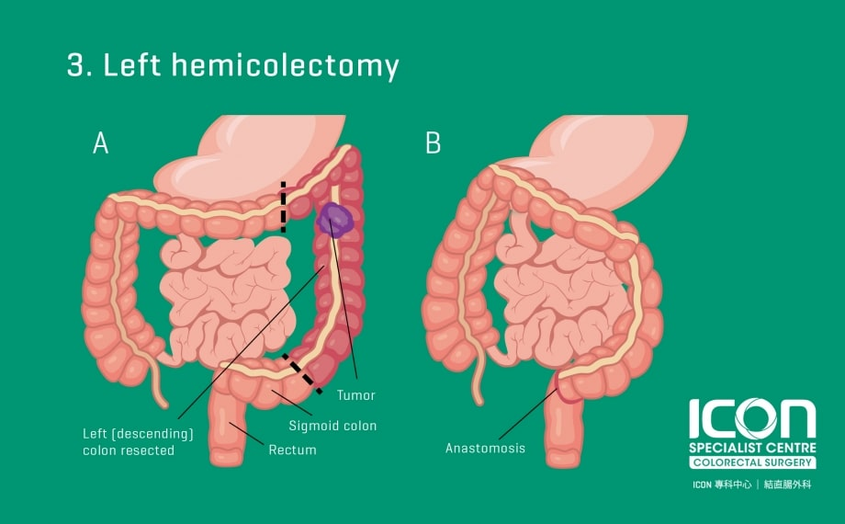

Slide 19
There are two main limitations to this study :-
1.Firstly, since long-term oncologic data are not available in the NSQIP database, the present study was not designed to assess cancer-related survival.
2.Secondly, there are inherent limitations to using a large database, specifically with regards to coding accuracy.
In summary, all of these studies, including our own, demonstrate that segmental colectomy for SFCs results in an adequate lymph node harvest with a safe post-operative course.

Slide 20
CONCLUSION
Segmental resection for SFCs is safe and provides an adequate oncologic lymph node harvest.
Based on the ACS-NSQIP database, the majority of surgeons not only seem to prefer segmental colectomies of the splenic flexure, but also opt for a laparoscopic approach.

Slide 21
References
1.Nakagoe T, Sawa T, Tsuji T, Jibiki M, Nanashima A, Yamaguchi H, Yasutake T, Ayabe H, Ishikawa H (2000) Carcinoma of the splenic flexure: multivariate analysis of predictive factors for clinicopathological characteristics and outcome after surgery. J Gastroenterol 35:528–535
2.Shaikh IA, Suttie SA, Urquhart M, Amin AI, Daniel T, Yalamarthi S (2012) Does the outcome of colonic flexure cancers differ from the other colonic sites? Int J Colorectal 27:89–93
3.Aldridge MC, Phillips RK, Hittinger R, Fry JS, Fielding LP (1986) Influence of tumour site on presentation, management and subsequent outcome in large bowel cancer. Br J Surg 73:663–670
4.Fukuoka A, Sasaki T, Tsukikawa S, Miyajima N, Ostubo T (2017) Evaluating distribution of the left branch of the middle colic artery and the left colic artery by CT angiography and colonography to classify blood supply to the splenic flexure. Asian J Endosc Surg 10:148–153
5.Chan D, Shah P, Soanes M, Skalni A (2013) Current trends and controversies in the management of patients with splenic flexure tumours. J Cancer Res Ther 1:8–10
6.Rega D, Pace U, Scala D, Chiodini P, Granata V, Fares Bucci A, Pecori B, Delrio P (2019) Treatment of splenic flexure colon cancer: a comparison of three different surgical procedures: experience of a high volume cancer center. Sci Rep 9:10953
7.Manceau G, Benoist S, Panis Y, Rault A, Mathonnet M, Goere D, Tuech JJ, Collet D, Penna C, Karoui M (2020) Elective surgery for tumours of the splenic flexure: a French inter-group (AFC, SFCD, FRENCH, GRECCAR) survey. Tech Coloproctol 24:191–198
8.Chenevas-Paule Q, Trilling B, Sage PY, Girard E, Faucheron JL (2020) Laparoscopic segmental left colectomy for splenic flexure carcinoma: a single institution experience. Tech Coloproctol 24:41–48
9.Kim CW, Shin US, Yu CS, Kim JC (2010) Clinicopathologic characteristics, surgical treatment and outcomes for splenic flexure colon cancer. Cancer Res Treat 42:69–76
10.Ardu M, Bergamini C, Martellucci J, Prosperi P, Valeri A (2019) Colonic splenic flexure carcinoma: is laparoscopic segmental resection a safe enough oncological approach? Surg Endosc 34:4436–4443

Slide 22
11.You YN, Chua HK, Nelson H, Hassan I, Barnes SA, Harrington J (2008) Segmental vs. extended colectomy: measurable differences in morbidity, function, and quality of life. Dis Colon Rectum 51:1036–1043
12.de Angelis N, Martinez Perez A, Winter DC, Landi F, Vitali GC, Le Roy B, Coccolini F, Brunetti F, Celentano V, Di Saverio S, Ris F, Fuks D, Espin E (2020) Extended right colectomy, left colectomy, or segmental left colectomy for splenic flexure carcinomas: a European multicenter propensity score matching analysis. Surg Endosc 35:661–67
13.Ko CY, Hall BL, Hart AJ, Cohen ME, Hoyt DB (2015) The American college of surgeons national surgical quality improvement program: achieving better and safer surgery. Jt Comm J Qual Patient Saf 41:199–204
14.Reddavid R, Esposito L, Evangelista A, Sofia S, Degiuli M (2019) Non-anatomical colonic resections: splenic flexure and transverse colectomy. Central vascular ligation is crucial for survival. Minerva Chir 74:176–186
15.Gravante G, Elshaer M, Parker R, Mogekwu AC, Drake B, Aboelkassem A, Rahman EU, Sorge R, Alhammali T, Gardiner K et al (2016) Extended right hemicolectomy and left hemicolectomy for colorectal cancers between the distal transverse and proximal descending colon. Ann R Coll Surg Engl 98:303–307
16.Crippa J, Grass F, Achilli P, Behm KT, Mathis KL, Day CN, Harmsen WS, Mari GM, Larson DW (2021) Surgical approach to transverse colon cancer: analysis of current practice and oncological outcomes using the national cancer database. Dis Colon Rectum 64:284–292
17.Vasey CE, Rajaratnam S, O’Grady G, Hulme-Moir M (2018) Lymphatic drainage of the splenic flexure defined by intraoperative scintigraphic mapping. Dis Colon Rectum 61:441–446
18.Watanabe J, Ota M, Suwa Y, Ishibe A, Masui H, Nagahori K (2017) Evaluation of lymph flow patterns in splenic flexural colon cancers using laparoscopic real-time indocyanine green fluorescence imaging. Int J Colorectal Dis 32:201–207
19.Degiuli M, Reddavid R, Ricceri F, Di Candido F, Ortenzi M, Elmore U, Belluco C, Rosati R, Guerrieri M, Spinelli A et al (2020) Segmental colonic resection is a safe and effective treatment option for colon cancer of the splenic flexure: a nationwide retrospective study of the Italian society of surgical oncology-colorectal cancer network collaborative group. Dis Colon Rectum 63:1372–1382
20.Odermatt M, Siddiqi N, Johns R, Miskovic D, Khan O, Khan J, Parvaiz A (2014) Short- and long-term outcomes for patients with splenic flexure tumours treated by left versus extended right colectomy are comparable: a retrospective analysis. Surg Today 44:2045–2051
21.Martin Arevalo J, Moro-Valdezate D, Garcia-Botello SA, Pla-Marti V, Garces-Albir M, Perez Santiago L, Vargas-Duran A, Espi-Macias A (2018) Propensity score analysis of postoperative and oncological outcomes after surgical treatment for splenic flexure colon cancer. Int J Colorectal Dis 33:1201–1213

