Slide 1
Single anastomosis sleeve - jejunal (SAS-J) bypass as a treatment for morbid obesity, technique and review of 1986 cases and 6 Years follow up
Retrospective cohort
  Original Author
  Sewefy, Alaa M. et al
  Published in International Journal of Surgery May 2022
  Review by
  Dr. Danie Jayanand, Junior Resident (I Year),
  Department of General Surgery, K.G.M.C., Asaripallam
  Unit Chief & H.o.D.: Prof. Dr. J. A. Jayalal, M.S., F.R.C.S., Ph.D.
  Assistant Professors: Dr. Edwin Kins Raj, M.S.
  Dr. P.R. Baghavath, M.S.

Slide 2
Introduction
According to WHO 13% (650 million) of the global population are affected by obesity.
Atheist 2.8 million people die from obesity and its comorbidities every year.
In patients with a body mass index (BMI) of ≥40 or ≥ 35 kg/m2 combined with comorbidities, surgical intervention is the most effective and lasting treatment.
However, several complications may occur, with nutritional deficiency being one of the most important. As nutritional deficiencies may be life-threatening, they require careful consideration.
The most frequently performed surgery for obesity worldwide is the Laparoscopic Sleeve Gastectomy (LSG), the Roux-en-Y gastric bypass (RYGB), and one anastomosis gastric bypass (OAGB).
Single Anastomosis Sleeve Jejunal (SAS-J) Bypass is simpler and safer than most bariatric surgeries, with minimal nutritional deficiencies and other combinations.
Single Anastomosis Sleeve Jejunal (SAS-J) Bypass is a modification of Single Anastomosis Sleeve Ileal (SASI) Bypass.

Slide 3
Material and methods
Retrospective review and analysis of prospectively collected data for patients who underwent SAS-J bypass between April 2016 and February 2021, which included 1986 patients.
All patients were given General Anaesthesia and placed in French position with a steep reverse-Trendelenburg position.
All patients were operated by the same surgeon
Study received on 25 February 2022;
Accepted 1 May 2022
Ethical Approval obtained from the Department of Surgery, Minia University, Ethical committee.

Slide 4
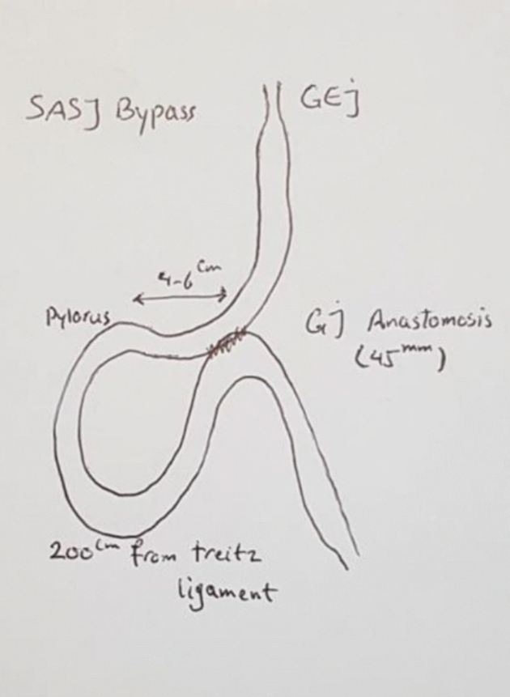
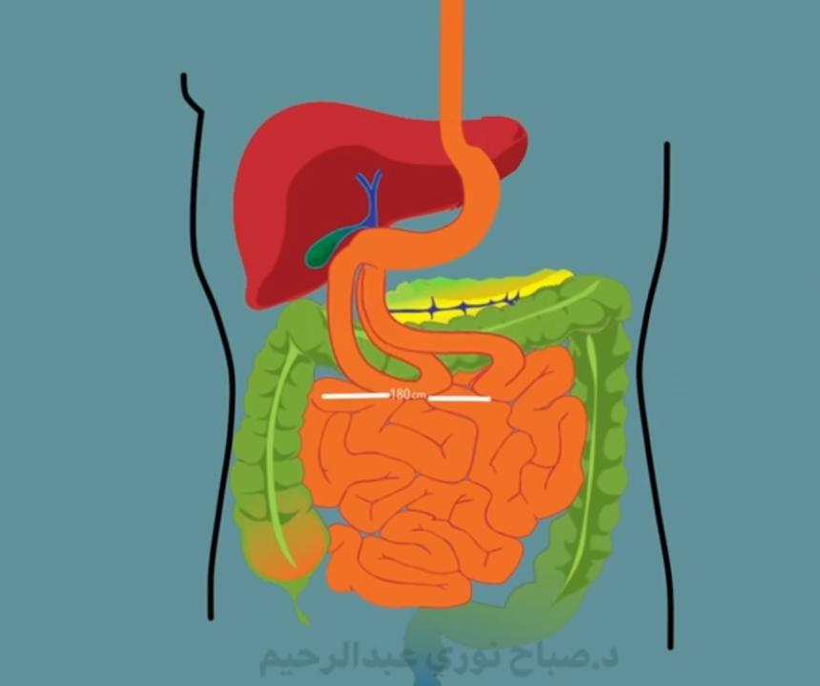
Surgical technique

Slide 5
As for the standard Laparoscopic Sleeve Gastectomy, the omentum is divided from the stomach. Continued division upward to the left crus of the diaphragm, and the crus is completely cleared from anterior adhesion. The stomach is completely freed posteriorly by dissecting any adhesions between it and the pancreas. The dissection continued toward the pylorus.
A 36 French bougie is used as calibration for the proper sleeve. The stapling is initiated 6 cm from the pyloric ring and continued to completely divide the stomach. The staple line is over-sewed using a running 3-0 Prolene suture. The sleeved stomach is routinely fixed to the crus of the diaphragm to prevent later migration of the stomach into the chest and decrease the incidence of reflux.

Slide 6
The duodenojejunal (DJ) junction is then identified and the total intestinal length is measured by number of counts instead of using a measure. Then, nearly one-third of total count from the DJ junction (for example, if the total intestinal count was 70, the anastomosis was done at 25 counts from DJ). This process standardized the procedure to percentage rather than a fixed length. The jejunum is fixed at the desired length with an orientation stitch to the pylorus.
The anastomosis between the jejunum and sleeved stomach is performed using a 45-blue cartridge at the dissected inferior border of the sleeved stomach. The defect in the gastrojejunal anastomosis is then closed by a 2-layer running suture.

Slide 7
Another orientation stitch is made at the left side of anastomosis between the jejunum and staple line of the stomach. The aim of these two orientation stitches was to: 1) minimize tension on the anastomosis, 2) make the anastomosis and the jejunal loop anatomically oriented without twisting, and 3) as an anti-reflux measure by the left orientation stitch.
Finally, a methylene blue leak test was performed

Slide 8
Advantages of SAS-J
1) the procedure is relatively simple and has a shorter operative time;
2) the ability to assess the entire gut and biliary tree by endoscope as it passes through the duodenum;
3) the lack of division of the duodenum, with no risk of stump leakage;
4) there is minimal traction on the anastomosis;
5) the absence of foreign bodies, blind loops, or excluded segments; and
6) it can be easily converted to another bariatric procedure
7) minimal nutritional deficiencies and without excessive weight loss

Slide 9
Data collection
Age, sex, body weight, height,
Obesity-related comorbidities,
Presence of gallstones,
Operative time,
Conversion into open surgery
Intraoperative and postoperative complications,
Postoperative data including weight loss and improvement of comorbidities,
Excessive weight loss,
Weight regain.

Slide 10
Study outcomes
Primary outcome :- the percentage of excess weight loss (%EWL).
Secondary outcomes :- intraoperative complications, operative time, early postoperative complications, remission of obesityrelated comorbidities, late postoperative complications, nutritional status, weight regain, and excessive weight loss, and follow-up duration.

Slide 11
Definition of outcomes
Weight loss was reported as %EWL as well as total weight loss percentage (%TWL).
The %EWL was calculated as [(preoperative weight – follow-up weight) ∕ preoperative weight −ideal weight] × 100.
The %TWL was calculated as [(preoperative weight – follow up weight) ∕ preoperative weight] × 100 [5].
Insufficient weight loss was defined as %EWL ≤50%.
WR (weight regain)is defined as Increase in BMI >35 kg/m2 after successful weight loss.

Slide 12
Follow-up
All patients were allowed early ambulation. Clear fluids were allowed 5 h after surgery. Thromboprophylaxis was administered for 2weeks. Proton pump inhibitors (PPIs) were administered for 3 months Postoperativey.l
Weekly for 1 month,monthly for 1 year. In the second year, follow-up occurred every 3 months. After 2 years, the follow-up occurred every 6 months.
Follow-up investigation every 3 months, which included complete blood count (CBC), liver function tests, serum albumin, hemoglobin A1c (HbA1c), lipid profile, fasting blood sugar, serum iron, and serum vitamin
High-concentration multivitamin supplement was prescribed for 2years.
Complications also were recorded.
One-year follow-ups were used to assess the effect of SAS-J bypass on Weight loss and comorbidities, and the five-year and later follow-ups were used to assess long-term results.

Slide 13
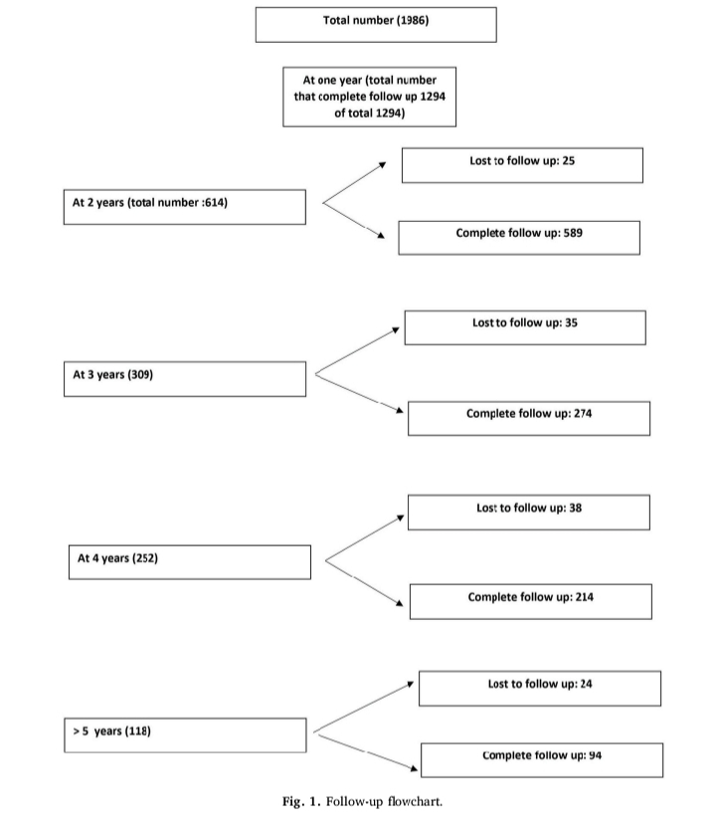

Slide 14
Statistical analysis
Data were expressed as percentages or as mean ± standard deviation.
The appropriate statistical methods were used for both parametric and non-parametric procedures, with a Student’s t-test used to compare continuous variables, a chi-square test used to compare categorical or ordinal variables, and a Friedman test used to compare multiple related variables.
A p-value of <0.05 was considered statistically significant.

Slide 15
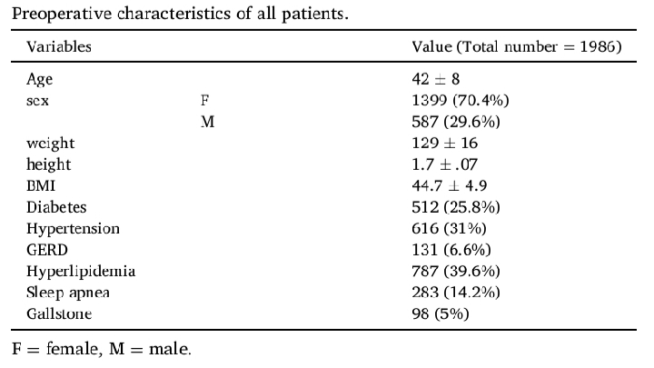
Results

Slide 16
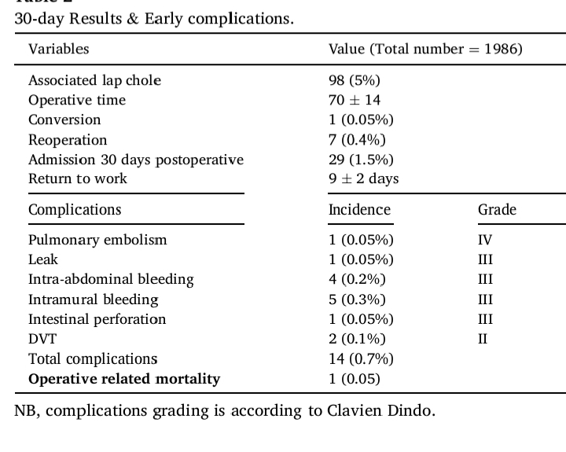
Operative and early postoperative results

Slide 17
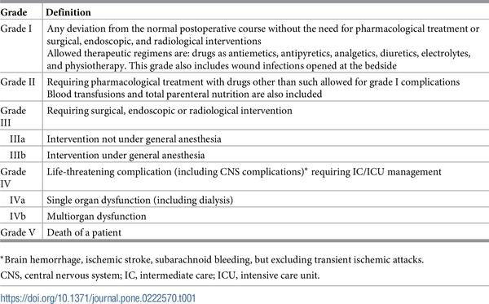
ClaviEn-dindo classification

Slide 18
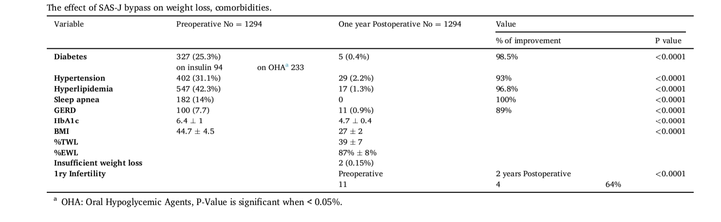
Short term effects

Slide 19
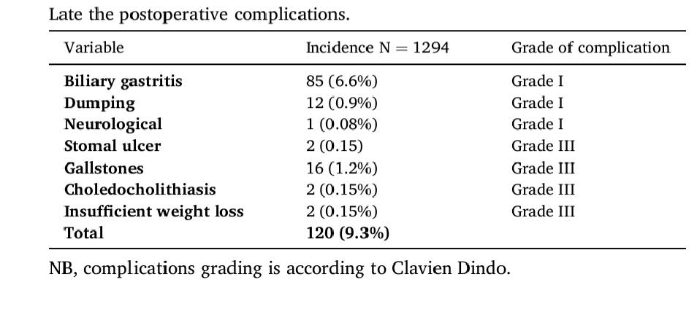
Late complications

Slide 20
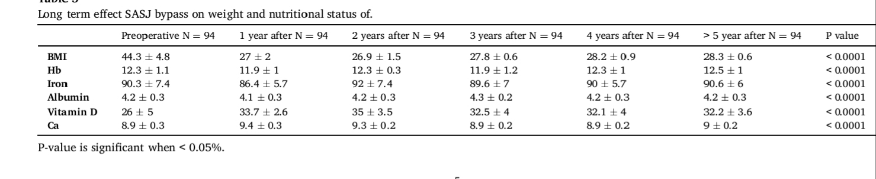
Long term effects

Slide 21
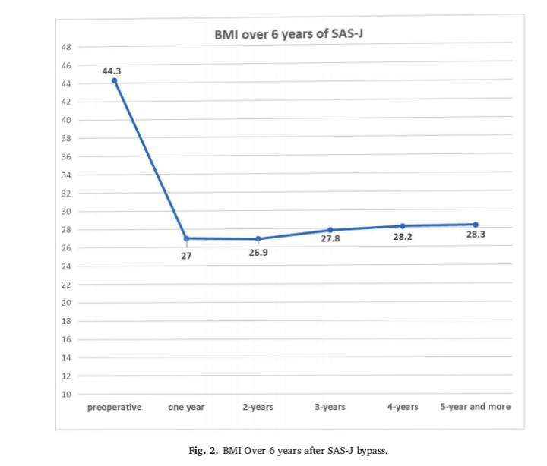

Slide 22
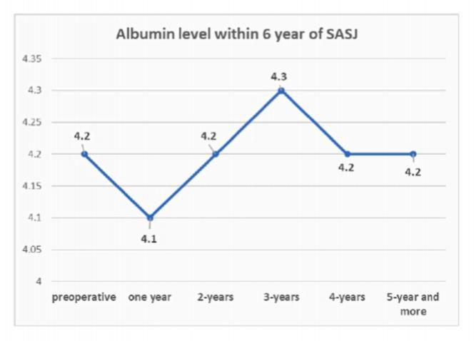
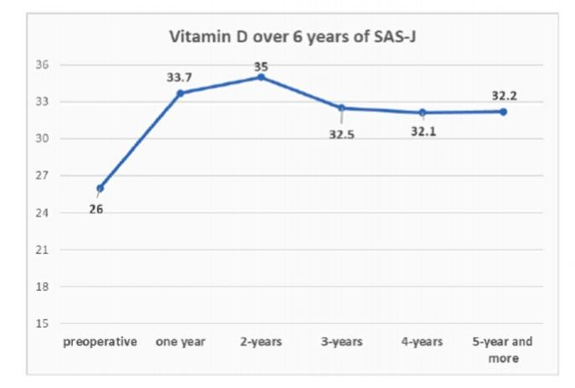
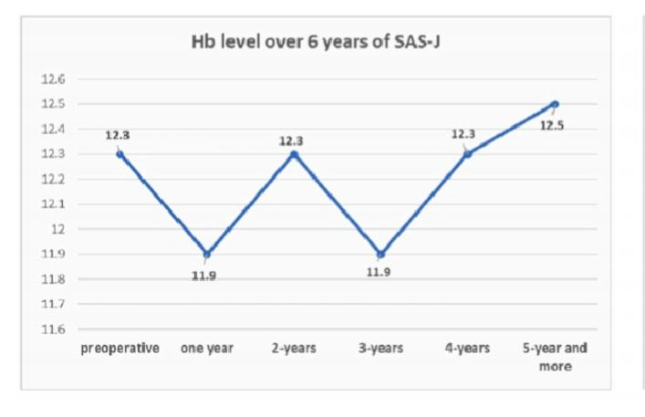
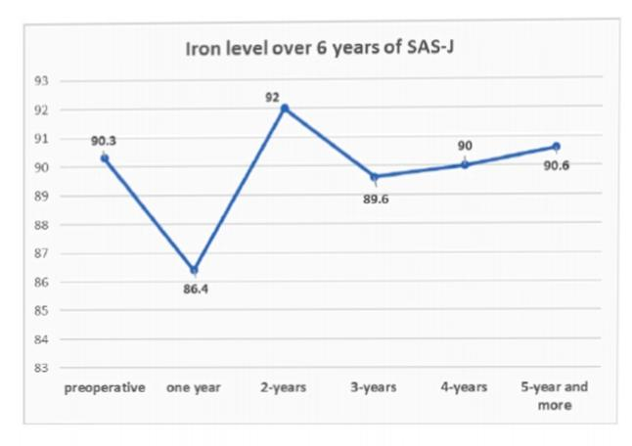
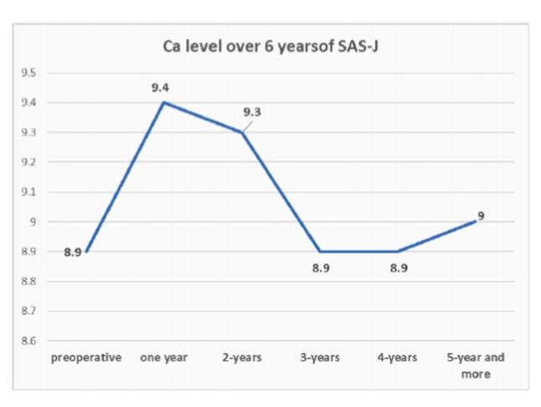

Slide 23
Bariatric surgery
AHA–ACC–TOS Guideline for the Management of Overweight and Obesity in Adults (2013)
This guideline advises that bariatric surgery could be an appropriate option to improve health in adults with a BMI >40kg/m2 (or BMI ≥35kg/m2 with obesity-related comorbid conditions), who are motivated to lose weight but have not responded to behavioural treatment (with or without pharmacotherapy) with sufficient weight loss to achieve targeted health outcome goals.
American Diabetes Association (2015)
bariatric surgery could be considered for adults with BMI of ≥35kg/m2 and T2DM, especially if T2DM or associated comorbidities are difficult to control with lifestyle and pharmacological therapy

Slide 24
Specific Bariatric Surgical Procedures
Restrictive in which the size of the gastric pouch is greatly reduced,
Malabsorptive in which malabsorption of nutrients contributes to weight loss, and
Combination of restrictive and malabsorptive component

Slide 25
The four most common bariatric operations performed worldwide are
Laparoscopic sleeve gastrectomy
Laparoscopic Roux-en-Y gastric bypass,
Laparoscopic adjustable gastric banding
Biliopancreatic duodenal switch

Slide 26
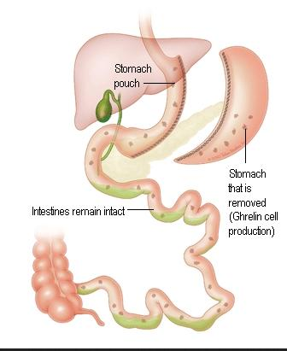
Sleeve gastrectomy

Slide 27
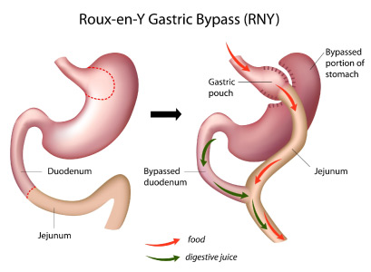
Roux-en-y gastric bypass

Slide 28
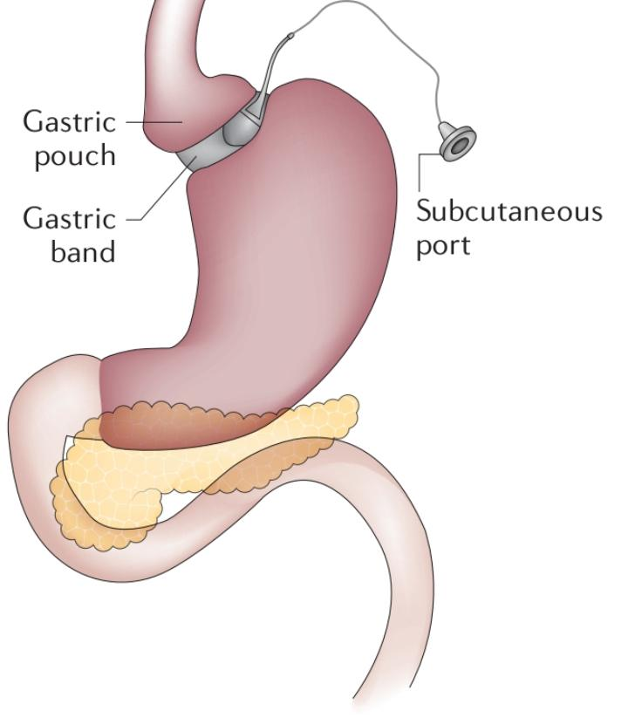
Adjustable gastric banding

Slide 29
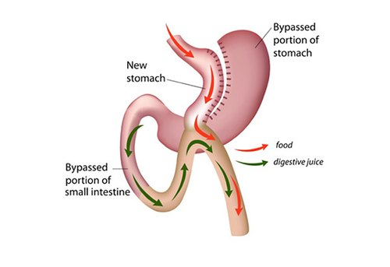
Duodenal switch

Slide 30
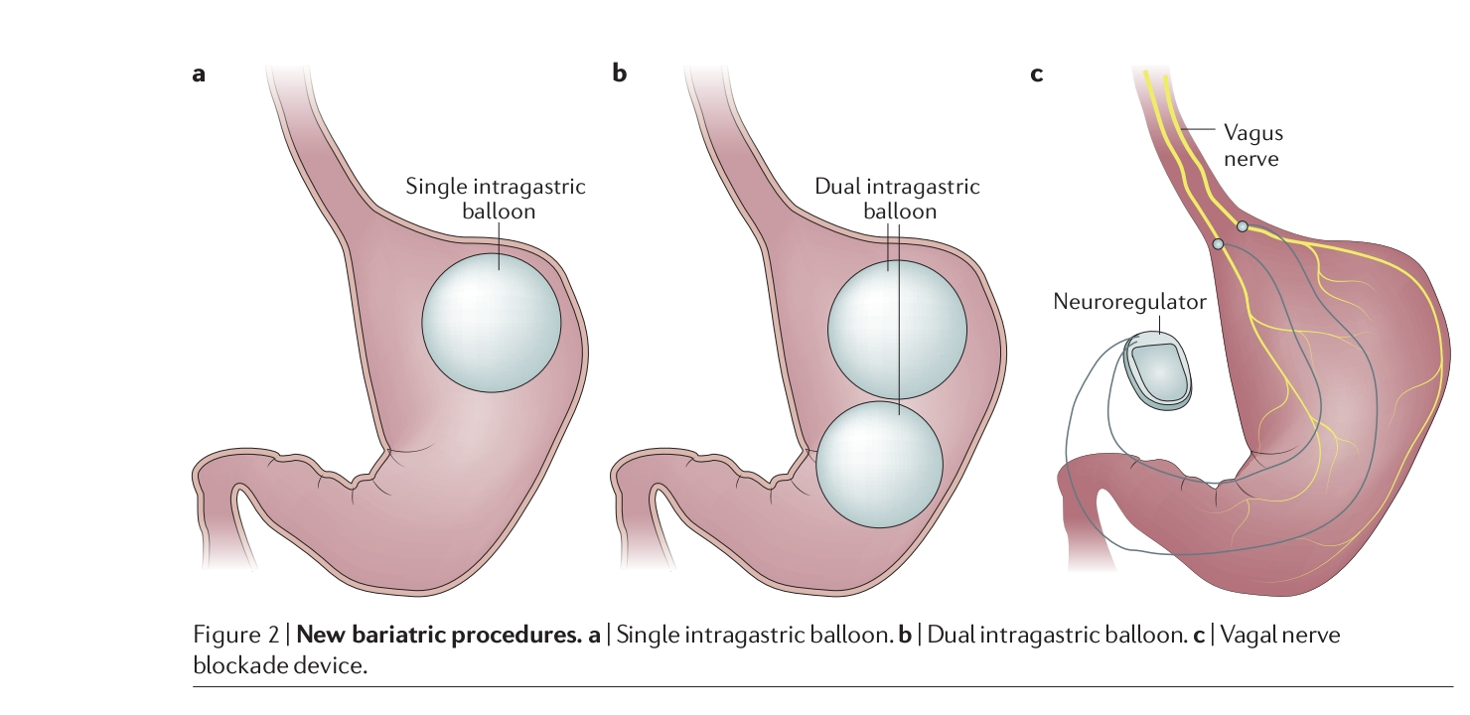
Newer procedures

Slide 31
SAS-J
Both restrictive and malabsorptive
Malabsorptive component has less potency compared with other procedures, because of the presence of duodenum and proximal jejunum in the alimentary pathway
SAS-J bypass with a shortened biliopancreatic limb (BPL) length (about one third of the total intestinal length associated with less malnutrition than long limb in OAGB and RYGB
In SAS-J bypass, neither the stomach nor the duodenum is bypassed, so endoscopic examination of gastrointestinal tract (GIT) remains accessible .
Therefore, in areas with a high prevalence of gastric adenocarcinoma, the SAS-J bypass may be the bariatric procedure of choice due to the retained abilityaccessible the GIT.

Slide 32
Following bypass surgeries such as RYGB, OAGB, and SADI, traditional transoral ERCP and upper GI endoscopy become unavailable due to the altered anatomy.
Many alternative techniques have been used to access the biliary tree, including transgastric ERCP, choledochoduodeonoscopy, transcystic common bile duct exploration, balloon enteroscopic ERCP, and EUSguided transhepatic ERCP.
These maneuvers are challenging, not performed in all institutions, and have a low rate of success (59%–70%) and high rate of complication

Slide 33
Conclusion
A bariatric option can be considered and adequate alternative if it can:
1) produce the same results on short- and long-term follow-up,
2) with an acceptable complication rate,
3) without bypassing the duodenum and proximal small intestine, and
4) leaving the residual stomach accessible.
Laparoscopic SAS-J bypass is an adequate, effective, and simple alternative bariatric procedure at short- and long-term follow-up.

Slide 34
References
[1] M.M. Finucane, G.A. Stevens, M.J. Cowan, G. Danaei, J.K. Lin, C.J. Paciorek, G. M. Singh, H.R. Gutierrez, Y. Lu, A.N. Bahalim, F. Farzadfar, L.M. Riley, M. Ezzati, Global Burden of Metabolic Risk Factors of Chronic Diseases Collaborating Group (Body Mass Index). National, regional, and global trends in body-mass index since 1980: systematic analysis of health examination surveys and epidemiological studies with 960 country-years and 9⋅1 million participants, Lancet 377 (9765(2011 Feb 12) 557–567, https://doi.org/10.1016/S0140-6736(10)62037-5.
[2] G.S. Jakobsen, M.C. Småstuen, R. Sandbu, N. Nordstrand, D. Hofsø, M. Lindberg, J.K. Hertel, J. Hjelmesæth, Association of bariatric surgery vs medical obesity treatment with long-term medical complications and obesity-related comorbidities, JAMA 319 (3) (2018 Jan 16) 291–301, https://doi.org/10.1001/ jama.2017.21055. PMID: 29340680; PMCID: PMC5833560.
[3] E. Mohos, Z. Jano, D. Richter, E. Schmaldienst, G. Sandor, P. Mohos, M. Horzov, G. Tornai, M. Prager, Quality of life, weight loss and improvement of comorbidities after primary and revisional laparoscopic roux Y gastric bypass procedure comparative match pair study, Obes. Surg. 24 (12) (2014 Dec) 2048–2054, https://doi.org/10.1007/s11695-014-1314-y. PMID: 24913243.
[4] J.H. Etienne, N. Petrucciani, M. Goetschy, J. Gugenheim, A.S. Schneck, A. Iannelli, Primary roux-en-Y gastric bypass results in greater weight loss at 15-year follow-up compared with secondary roux-en-Y gastric bypass after failure of gastric Band or Mason McLean Vertical Gastroplasty, Obes. Surg. 30 (10) (2020 Oct) 3655–3668, https://doi.org/10.1007/s11695-020-04728-5. PMID: 32488745.

Slide 35
[5] A.M. Sewefy, A. Saleh, The outcomes of single anastomosis sleeve jejunal bypass as a treatment for morbid obesity (Two-year follow-up), Surg. Endosc. (2020), https://doi.org/10.1007/s00464-020-08029-x.
[6] F.G. Wang, Z.P. Yu, W.M. Yan, M. Yan, M.M. Song, Comparison of safety and effectiveness between laparoscopic mini-gastric bypass and laparoscopic sleeve gastrectomy: a meta-analysis and systematic review, Medicine (Baltim.) 96 (50) (2017 Dec), e8924, https://doi.org/10.1097/MD.0000000000008924. PMID: 29390281; PMCID: PMC5815693.
[7] F.G. Wang, W.M. Yan, M. Yan, M.M. Song, Outcomes of Mini vs Roux-en-Y gastric bypass: a meta-analysis and systematic review, Int. J. Surg. 56 (2018 Aug) 7–14, https://doi.org/10.1016/j.ijsu.2018.05.009. Epub 2018 May 16. PMID: 29753952.
[8] W.L. Mui, D.W. Lee, K.K. Lam, Laparoscopic sleeve gastrectomy with loopbipartition: a novel metabolic operation in treating obese type II diabetes mellitus, Int. J. Surg. Case Rep. 5 (2) (2014) 56–58, https://doi.org/10.1016/j. ijscr.2013.12.002
[9] A. Pazouki, M. Kermansaravi, Single anastomosis sleeve-jejunal bypass: a new method of bariatric/metabolic surgery, Obes. Surg. 29 (11) (2019 Nov) 3769–3770, https://doi.org/10.1007/s11695-019-04016-x. PMID: 31254211.
[10] T. Mahdy, A. Al Wahedi, C. Schou, Efficacy of single anastomosis sleeve ileal (SASI) bypass for type-2 diabetic morbid obese patients: gastric bipartition, a novel metabolic surgery procedure: a retrospective cohort study, Int. J. Surg. 34 (2016Oct) 28–34, https://doi.org/10.1016/j.ijsu.2016.08.018. Epub 2016 Aug 19. PMID: 27545956.
[11] R. Agha, A. Abdall-Razak, E. Crossley, N. Dowlut, C. Iosifidis, G. Mathew, for the STROCSS Group, The STROCSS 2019 Guideline: strengthening the reporting of cohort studies in surgery, Int. J. Surg. 72 (2019) 156–165.
[12] M. Nedelcu, H.A. Khwaja, T.G. Rogula, Weight regain after bariatric surgery-how should it be defined? Surg. Obes. Relat. Dis. Off. J. Am. Soc. Bariatr. Surg. 12 (2016) 1129–1130.

